Slide 1
Data Mining Lab
- Using WEKA Tool

Slide 2
Couse Outcomes
CO 1
CO 2
CO 3
CO 4
Demonstrate data preprocessing techniques
Demonstrate Association Rule Mining techniques.
Demonstrate Classification techniques.
Demonstrate the Clustering techniques.

Slide 3

Experiment 0
Weka Introduction

Slide 4
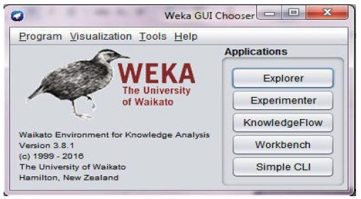
Open source software provides the tools for data preprocessing, implementation of several Data Mining and Machine Learning tasks and visualization.

Slide 5
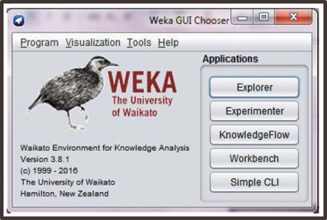
Weka is developed by University of Waikato in New Zealand.
“Weka” stands for the Waikato Environment for Knowledge Analysis.
It is written using Java.
Can download and install from https://waikato.github.io/weka-wiki/downloading_weka/

Slide 6
Explorer: Gives access to all Weka’s facilities using menu selection and form filling.
Experimenter: Compares a variety of learning techniques interactively.
KnowledgeFlow: Allows us to design configurations for streamed data processing. (Explorer holds everything in main memory).
Workbench: Combines Explorer, Expermenter and Knowledgeflow into one application.
Simple CLI: Simple Command Line Interface.
Weka GUI Chooser - Applications

Slide 7
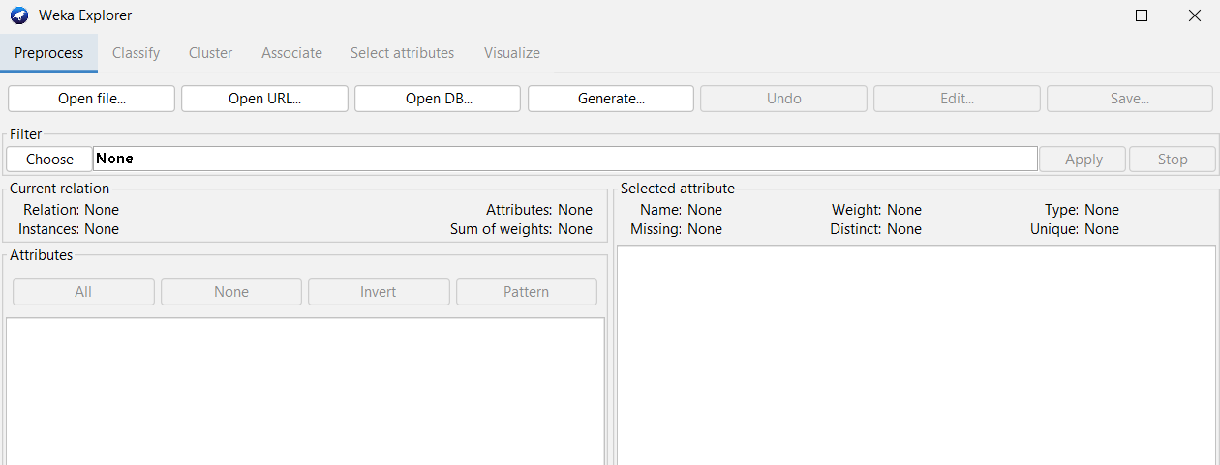
Weka Data Formates
In Weka datasets can be loaded from any one of the following sources:
Files (.arff, .csv, …)
Web
Database

Slide 8
Weka Data Formates . . .
Loading data from local file system:
Default file format for Weka is ARFF (Attribute Relation File Format).
@relation "employee"
@attribute id numeric
@attribute name string
@attribute contact_num numeric
@attribute dept {HR,IT,MANAGEMENT,MAINTAINANCE}
@attribute DOB date dd-mm-yyyy
@attribute city string
@data
1,naman,1234556678,IT,02-08-2000,rjt
2,yash,1234556679,HR,04-05-2001,amd
3,kishan,1214556678,MANAGEMENT,02-11-2001,pbr
4,?,5234556678,IT,03-05-2000,amd
Tags:
The @relation tag defines the name of the database.
The @attribute tag defines the attributes.
The @data tag starts the list of data rows each containing the comma separated fields.
Data types:
nominal: categorical values - represented inside curly brackets.
string : data type which accepts only string value
numeric: used to store numbers
date: used to store date

Slide 9
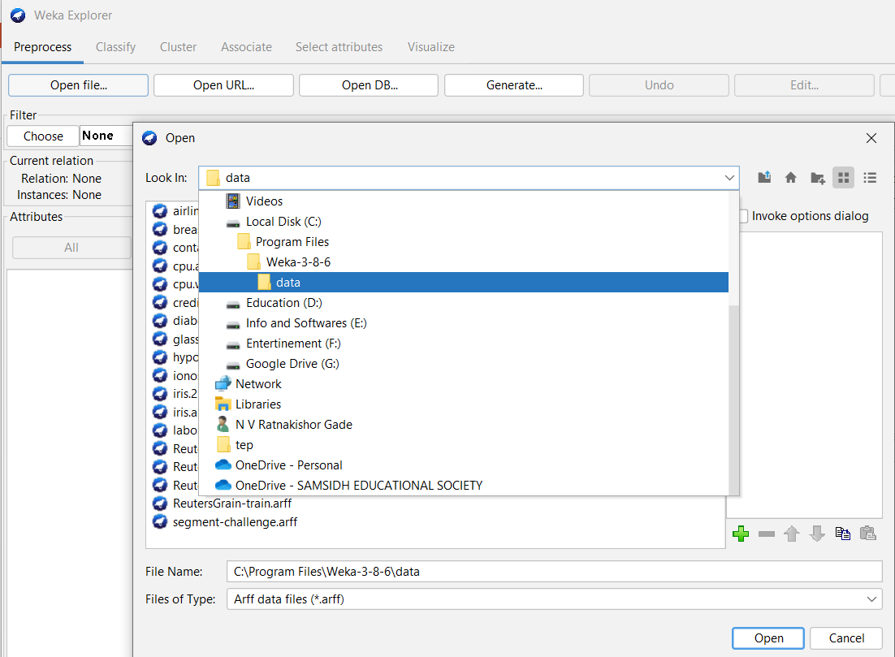
Weka Data Formates . . .
Loading data from local file system:
Default file format for Weka is ARFF (Attribute Relation File Format).
Weka is preloaded with some sample dataset files in its data folder.

Slide 10
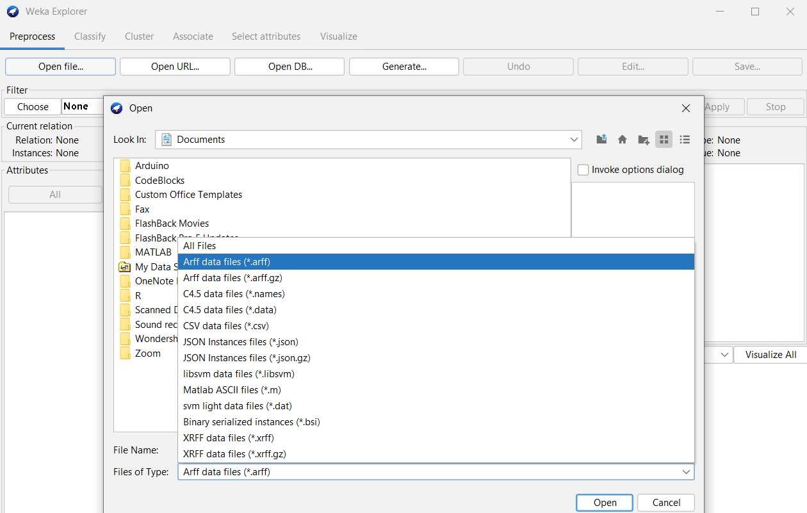
Weka Data Formates . . .
Loading data from local file system:
Weka also supports other file formats, one can be selected while opening the file.

Slide 11
Experiment 1
Data Preprocessing - 1

Slide 12
Tasks
01
02
03
Experiment 1
Load the labor.arff dataset and explore it.
Handling missing values
Normalization / Standardization

Slide 13
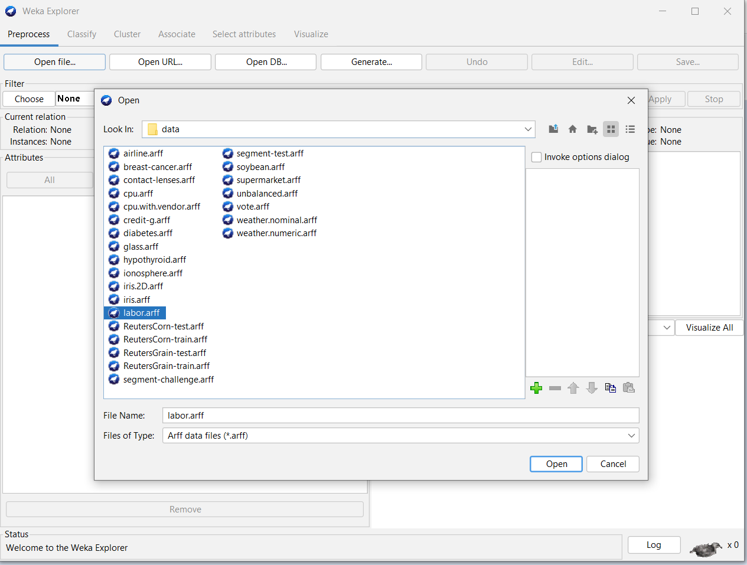
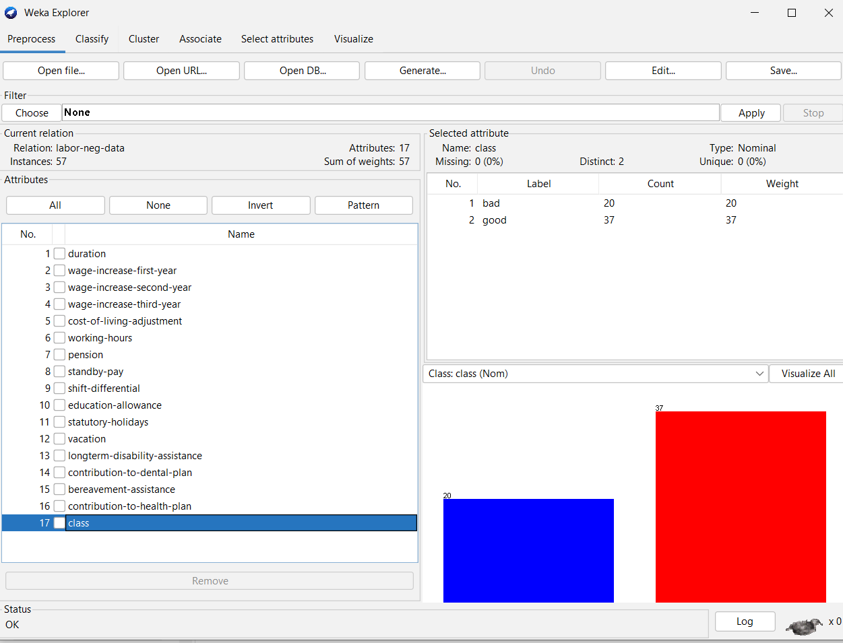
Task 1.1: Loading labor.arff dataset
Experiment 1
Explorer → Preprocess → Open file → Weka’s data folder → labor.arff.
Number of instances:
Number of attributes:
Target attribute:
Number of Target Classes:
Is it balanced dataset?
Identify the type of attributes.
Any missing values?
Use Edit.. window to view end edit the dataset

Slide 14
Task 1.2: Handling Missing Values
Experiment 1
Handling missing values
Removing instances with missing values
Imputation
Filters can be used:
RemoveWithValues
Removes the instances that contain the given value in an attribute.
ReplaceMissingValues
Replaces all missing values for nominal and numeric attributes in a dataset with the mode and mean from the training data.
ReplaceMissingWithUserConstat

Slide 15
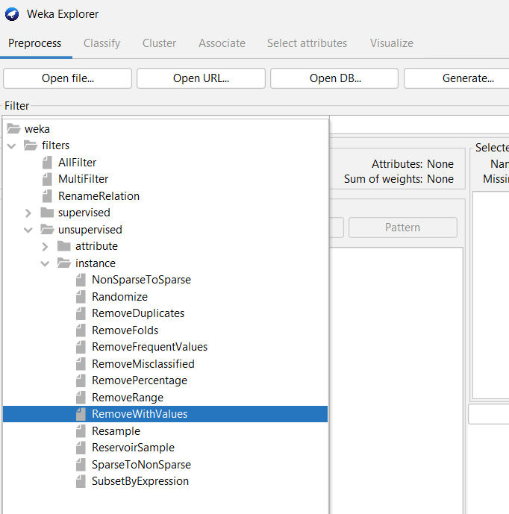
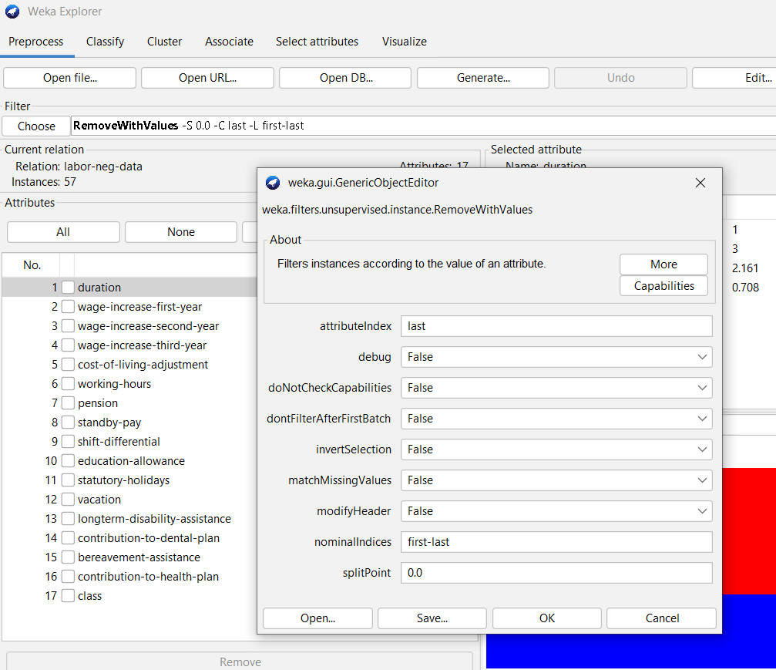
Task 1.2: Handling Missing Values
Experiment 1
Removing instances with missing values
Choose → Filter → Unsupervised → instance → RemoveWithValues
Click on selected filter to open its properties window.
Enter the attribute index
Select True for matchMissingValues
Click on ok
Click on Apply
Use Undo button to revert the changes

Slide 16
Task 1.2: Handling Missing Values
Experiment 1
Removing instances with missing values…
Note: Steps for Nominal attribute
Use Choose → Filter →Unsupervised → Attribute → ReplaceMissingWithUserConstant filter to replace missing values with a constant.
Enter Attribute index at attributes parameter.
Enter constant value at nominalStringReplaceValue.
Use Choose → Filter → Unsupervised → instance → RemoveWithValues filter to remove the instances with filled constant.
Enter attributeIndex.
Enter the index of filled constant label at nominalIndices.

Slide 17
Task 1.2: Handling Missing Values
Experiment 1
Removing instances with missing values…
Number of instances in the data set
Attribute name and index selected
Number of missing values in the selected attribute
Number of instances after filter is applied

Slide 18
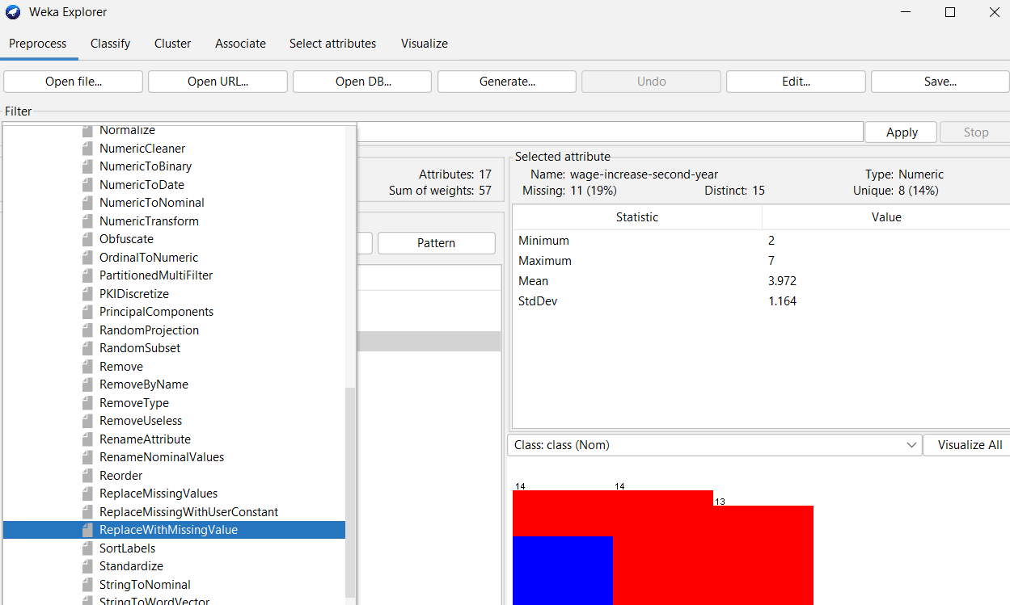
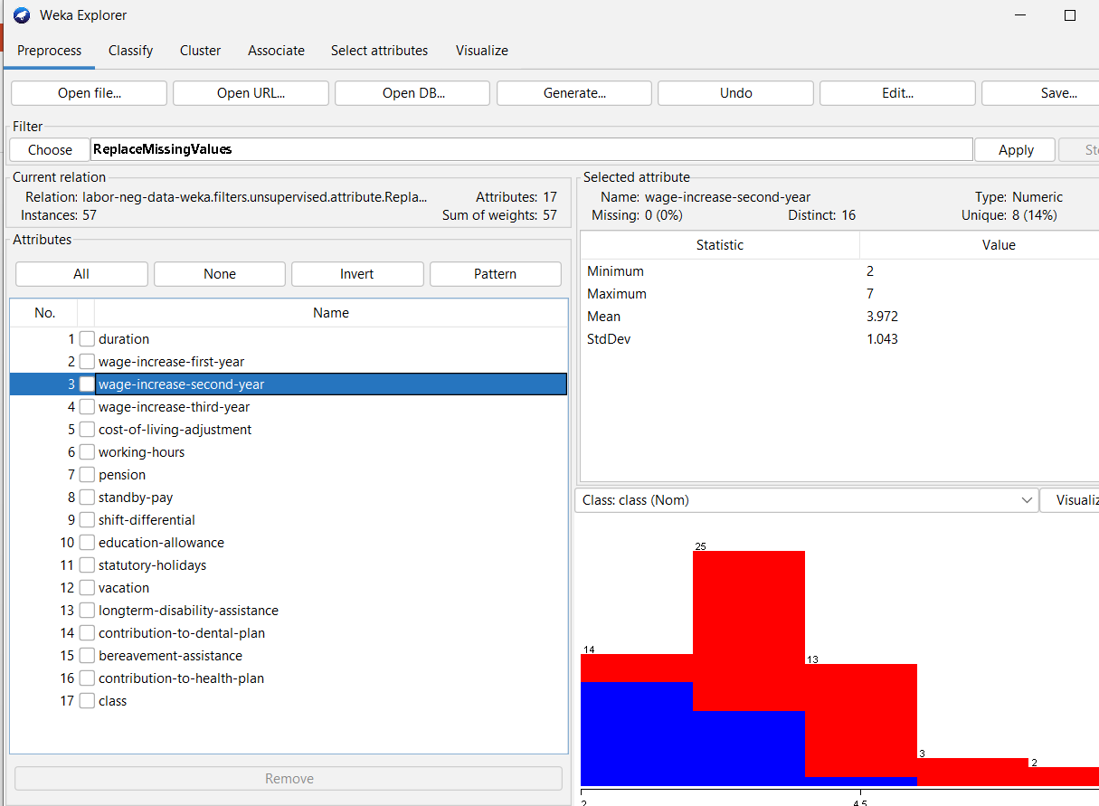
Task 1.2: Handling Missing Values
Experiment 1
Imputation with mean/mode values:
Choose → Filter → Unsupervised → Attribute → ReplaceMissingValues
Change the properties, if required.
Click on Apply
»» Observe the missing values for all the attributes after applying the filter.
Attribute | Type | Missing values are replaced with?

Slide 19
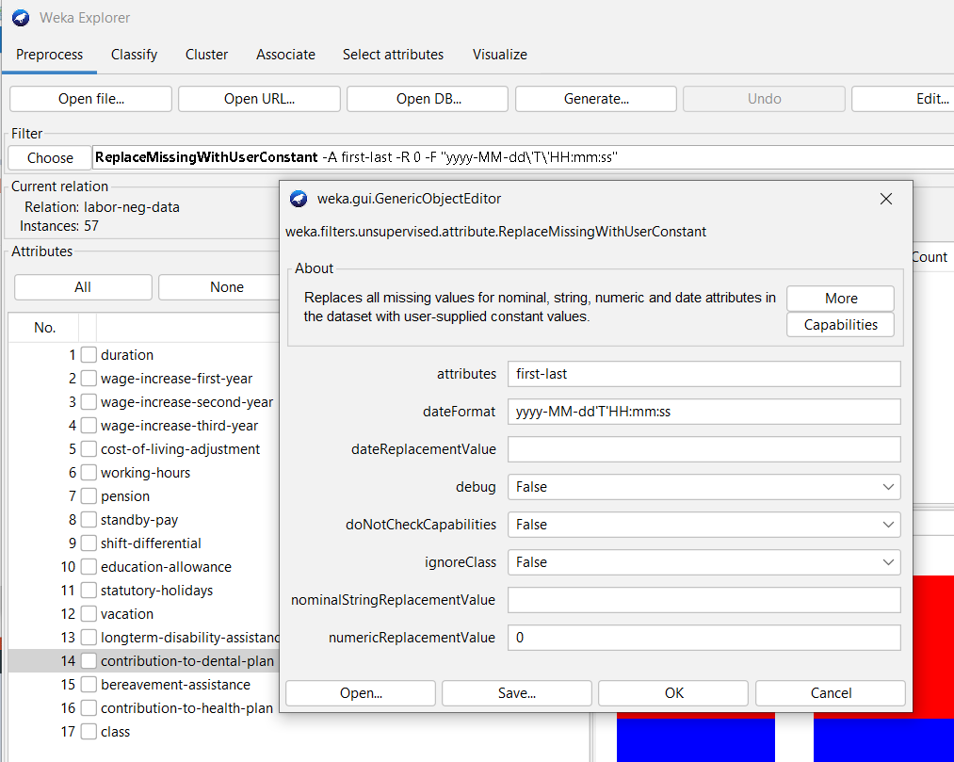
Task 1.2: Handling Missing Values
Experiment 1
Imputation with User Constant:
Choose → Filter → Unsupervised → Attribute → ReplaceMissingWithUserConstant.
Open the filter properties by a click.
Select the attribute index
Enter date/nominal/numericReplacementValue
Click Ok
Click Apply
»» Note down your observations after applying filter to any attribute

Slide 20
Task 1.3: Normalization & Stadardization
Experiment 1
Normalization:
Rescaling all the numeric attributes to the range 0 to 1.
Filter → Unsupervised → Attribute → Normalize
Default range [0, 1]
Range can be changed to [-1, 1] by parameter values scale = 2 and translation = -1.
Standardization:
Rescaling all the numeric attributes, such that they all have mean = 0 and SD = 1.
Filter → Unsupervised → Attribute → Standardize

Slide 21
Task 1.3: Normalization & Stadardization
Experiment 1
Name of the Numeric Attribute | Actual Characteristics (Min, Max, Mean & SD) | Characteristics After Normalization | Characteristics After Standardization

Slide 22
Experiment 2
ARFF File Creation & Preprocessing

Slide 23
Tasks
01
02
03
04
Experiment 2
Create student.arff dataset.
Handling missing values
Discretization of an attributes
Normalization / Standardization

Slide 24
Task 2.1: Creation of student.arff
Experiment 2
Open any text editor (e.g. notepad)
Using @relation, @attribute and @data tags enter the data in to the file with some missing values (?).
Attributes: Name, RollNo, Gender, Age, IQ (1 -10), score.
Save the file as student.arff.
Load student.arff in to Weka.

Slide 25
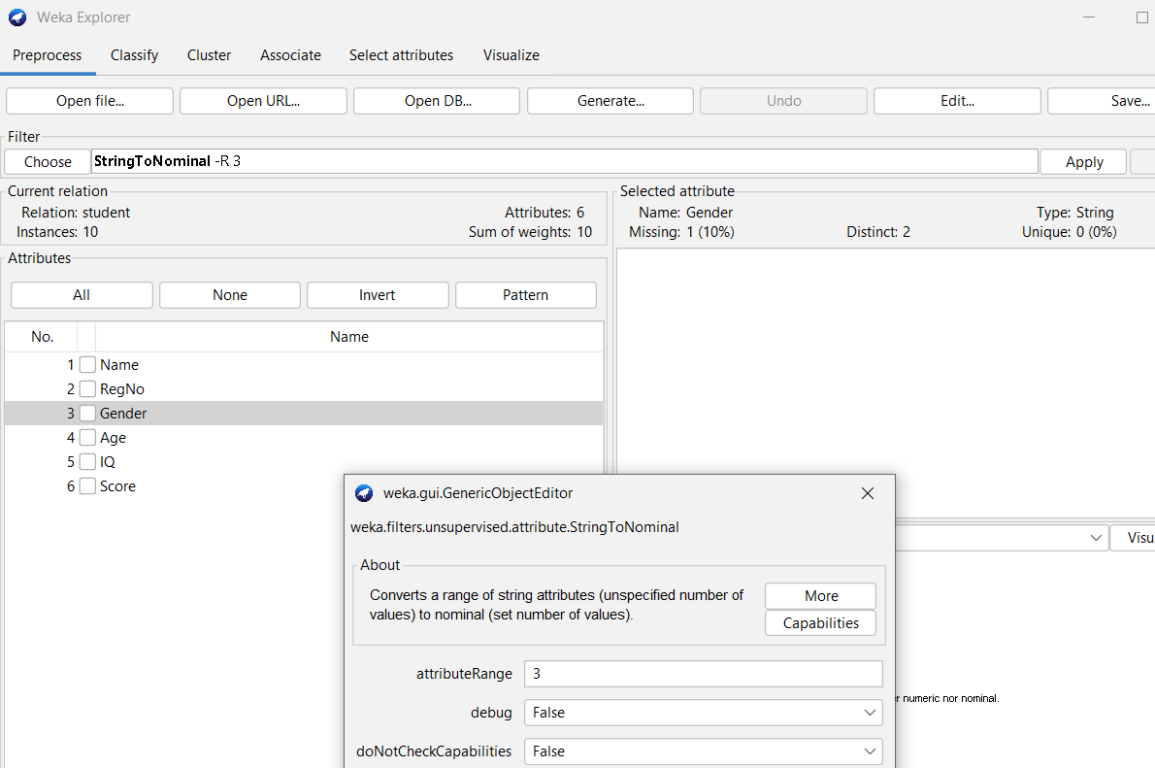
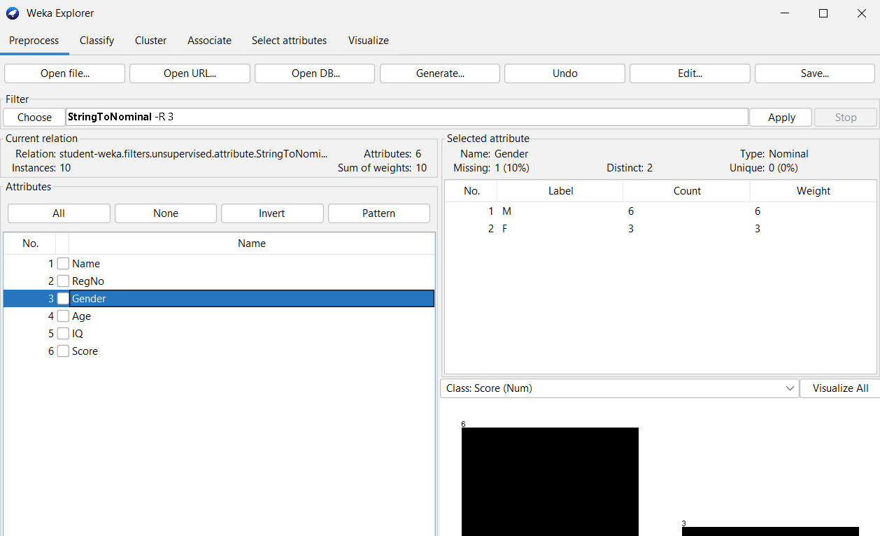
Task 2.1: Creation of student.arff…
Experiment 2
We can use Filter → Unsupervised → Attribute → StringToNominal to
convert the attribute type from string to nominal.
@relation student
@attribute Name string
@attribute RegNo string
@attribute Gender string
@attribute Age numeric
@attribute IQ numeric
@attribute Score numeric
@data
Ramu,20A81A0501,M,40,7,80
Raju,20A81A0502,M,20,?,86
Rani,20A81A0503,F,25,4,68
Girish,20A81A0504,?,39,5,53
Anji,20A81A0505,M,29,6,96
Sri,20A81A0506,F,33,4,76
Subbu,20A81A0507,M,41,9,84
Raghu,20A81A0508,M,?,5,53
Chinni,20A81A0509,F,33,6,78
Appu,20A81A0510,M,39,5,62
Note: We can make Gender attribute nominal while file creation
@attribute Gender {M, F}

Slide 26
Task 2.2: Handling missing values
Experiment 2
Use Filter → Unsupervised → Attribute → ReplaceMissingValues filter to fill missing numeric attribute values with mean and nominal values with mode.
To fill the missing values in the class(target – default is last) attribute, make ignoreClass parameter True.
»» Observe the missing values for all the attributes after applying the filter.
Attribute | Type | Missing values are replaced with?

Slide 27
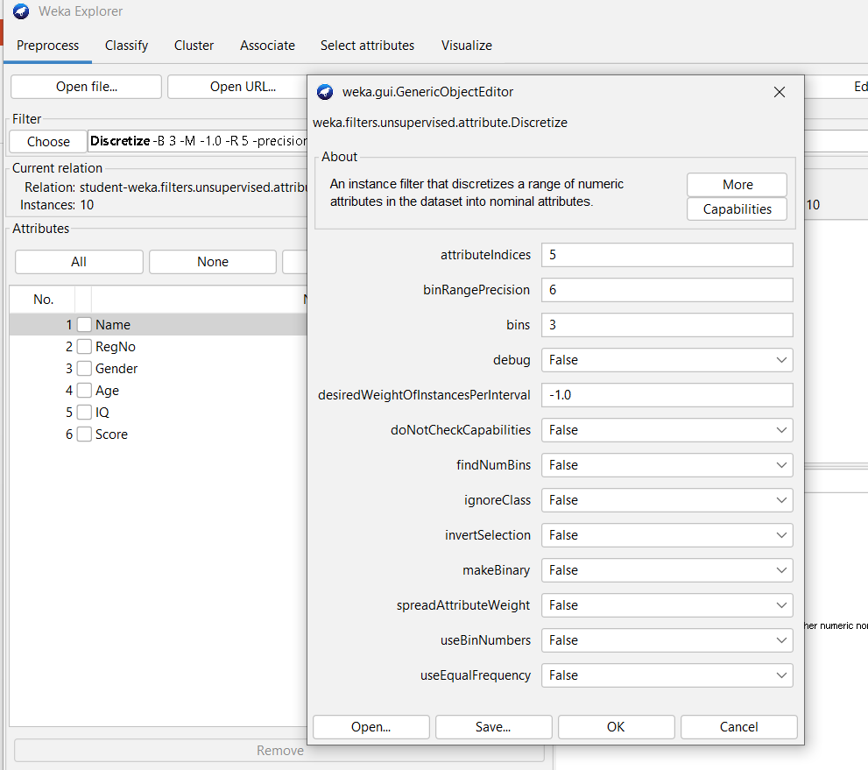
Task 2.3: Discretizing an attribute
Experiment 2
Select Filter → Unsupervised → Attribute → Discretize filter to convert a numeric attribute as nominal attribute.
Open the filter’s object editor.
Enter the attributeIndeces to be discretized.
Enter the bins you want for the attribute.
Click ok
Click Apply

Slide 28
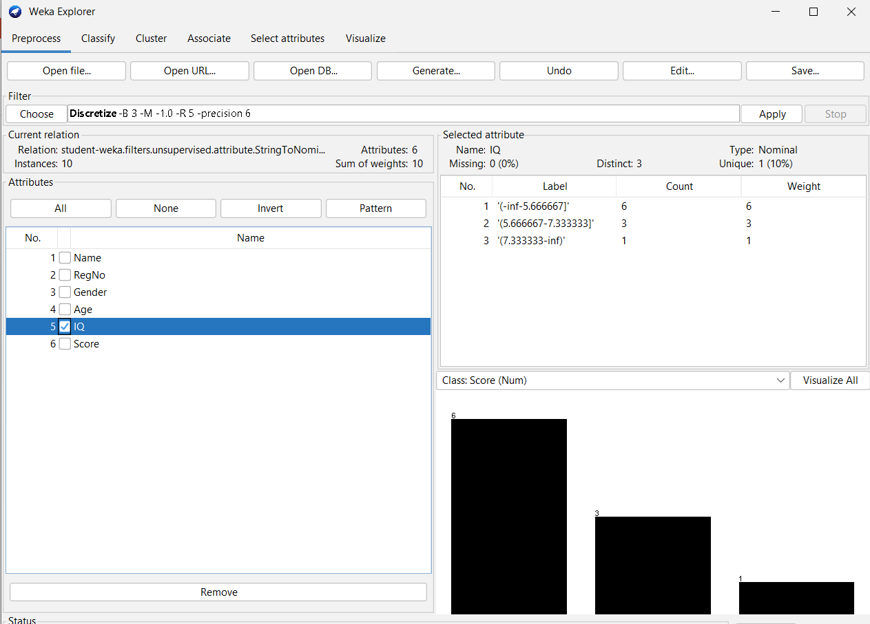
Task 2.3: Discretizing an attribute…
Experiment 2
Numeric Attribute | Number of Bins | Bin-wise Instances Count
We can use useBinNumbers parameter to change the labels to
Bxofy format.

Slide 29
Task 2.4: Normalization & Standardization
Experiment 2
Normalization:
Rescaling all the numeric attributes to the range 0 to 1.
Filter → Unsupervised → Attribute → Normalize
Default range [0, 1]
Range can be changed to [-1, 1] by parameter values scale = 2 and translation = -1.
Standardization:
Rescaling all the numeric attributes, such that they all have mean = 0 and SD = 1.
Filter → Unsupervised → Attribute → Standardize

Slide 30
Task 2.4: Normalization & Standardization…
Experiment 2
Name of the Numeric Attribute | Actual Characteristics (Min, Max, Mean & SD) | Characteristics After Normalization | Characteristics After Standardization

Slide 31
Experiment 3
Association Rule Mining

Slide 32
Tasks
01
02
03
Experiment 3
Load contact-lenses.arff dataset and explore it
Apply Apriori algorithm with default parameters
Change the parameters and observe the results

Slide 33
Task 3.1: Load conntact-lenses.arff and explore it
Experiment 3
Go to Explorer → OpenFile → Browse C:/Program Files/Weks-x-x-x/data → open contact-lenses.arff file.
Attribute | States and their meaning
age
spectacle-prescript
astigmatism
tear-prod-rate
contact-lenses

Slide 34
Task 3.2: Apply Apriori Algorithm with default Parameters.
Experiment 3
Association Rule Mining
It is a data mining process that finds features which occur together or features that are correlated.
Applications:
Market Basket Analysis
Cross Marketing

Slide 35
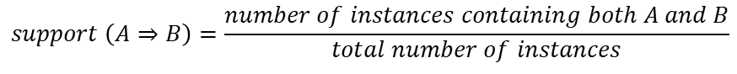
Task 3.2: Apply Apriori Algorithm with default Parameters.
Experiment 3
Association Rule Mining…
Association rules are mined out after frequent itemsets in a big dataset which can be found using algorithms such as Apriori and FP Growth.
Frequent Itemset mining mines data using support and confidence measures.
$$support \left(A⇒B\right)=\frac{number of instances containing both A and B}{total number of instances}$$
$$confidence \left(A⇒B\right)=p\left(B/A\right)=\frac{number of instances containing both A and B}{number of instances containing A}$$

Slide 36
Task 3.2: Apply Apriori Algorithm with default Parameters.
Experiment 3
Association Rule Mining…
Apriori Rule Learner:
Implements Apriori algorithm.
Iteratively reduces the minimum support from its upperBound until
it finds the required number of rules with the given minimum confidence or
the minimum support reaches lowerBound

Slide 37
Task 3.2: Apply Apriori Algorithm with default Parameters.
Experiment 3
Association Rule Mining…
Apriori Rule Learner …
Default values:
lowerBoundMinSupport = 0.1 (10%)
upperBoundMinSupport = 1.0 (100%)
metricType = Confidence
minMetric = 0.9 (90%)
numRules = 10

Slide 38
Task 3.2: Apply Apriori Algorithm with default Parameters.
Experiment 3
Association Rule Mining…
Apriori Rule Learner…
Steps:
Select Associate → Choose → associations → Apriori.
Observe the default parameter values.
Click on Start.

Slide 39
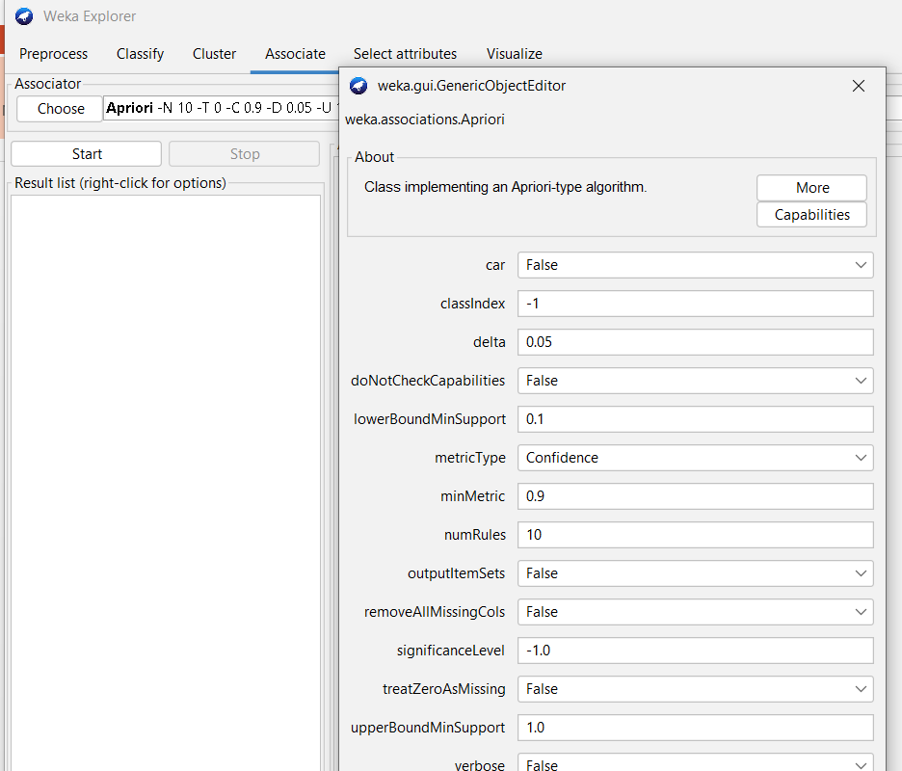
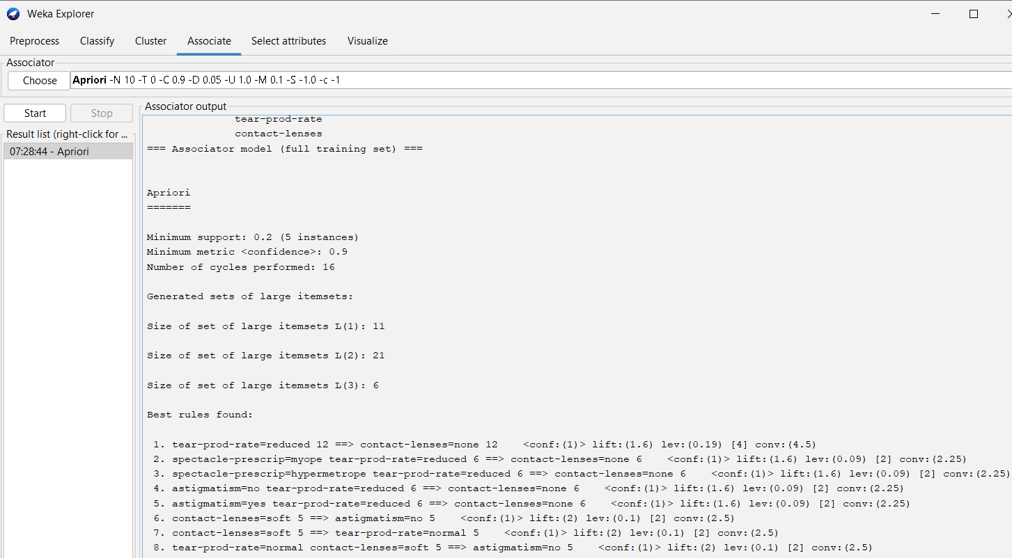
Task 3.2: Apply Apriori Algorithm with default Parameters.
Experiment 3
Association Rule Mining…
Apriori Rule Learner…

Slide 40
Task 3.2: Apply Apriori Algorithm with default Parameters.
Experiment 3
Association Rule Mining…
Apriori Rule Learner…
Default Parameters | Observations
lowerBoundMinSupport = upperBoundMinSupport = metricType = minMetric = numRules = | Minimum support = Minimum Metric <Confidence> = Number of cycles performed = Best rules found with confidence: 1. 2. 3. 4. 5. 6. 7. 8. 9. 10.

Slide 41
Task 3.3: Apply Apriori Algorithm with required Parameters.
Experiment 3
Association Rule Mining…
Apriori Rule Learner…
Parameters | Observations
lowerBoundMinSupport = upperBoundMinSupport = metricType = minMetric = numRules = | Minimum support = Minimum Metric <Confidence> = Number of cycles performed = Best rules found with confidence:

Slide 42
Task 3.3: Apply Apriori Algorithm with required Parameters.
Experiment 3
Association Rule Mining…
Apriori Rule Learner…
Parameters | Observations
lowerBoundMinSupport = upperBoundMinSupport = metricType = minMetric = numRules = | Minimum support = Minimum Metric <Confidence> = Number of cycles performed = Best rules found with confidence:

Slide 43
Experiment 4
Association Rule Mining on Employee Data set

Slide 44
Tasks
01
02
03
Experiment 4
Create employee.arff dataset and load it into Weka
Apply Apriori algorithm with default parameters
Change the parameters and observe the results

Slide 45
Task 4.1: Create employee.arff dataset and load it.
Experiment 4
Create employee.arff with following categorical attributes and load it.
Attribute | States
Designation | Manager Developer Tester
Beneficiary | Yes No
GPF | Yes No
Salary | Low Medium High
CreditRating | Poor Fair Excellent
BankLoan | Yes No

Slide 46
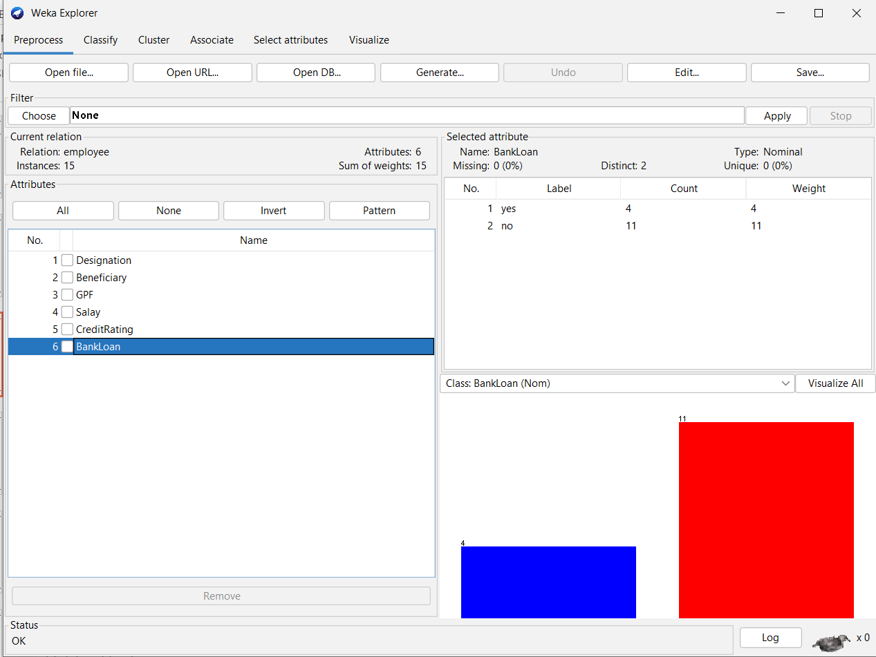
Task 4.1: Create employee.arff dataset and load it…
Experiment 4
@relation employee
@attribute Designation {manager, developer, tester}
@attribute Beneficiary {yes, no}
@attribute GPF {yes, no}
@attribute Salay {low, medium, high}
@attribute CreditRating {poor, fair, good}
@attribute BankLoan {yes, no}
@data
developer,yes,yes,medium,fair,no
tester,no,no,high,good,no
manager,yes,no,medium,fair,no
developer,yes,no,high,fair,yes
developer,yes,no,high,fair,no
developer,yes,yes,high,fair,yes
manager,yes,no,low,poor,no
manager,yes,yes,medium,fair,yes
manager,yes,no,high,good,no
developer,no,no,medium,good,no
tester,yes,no,medium,fair,no
developer,yes,no,medium,fair,yes
tester,no,no,low,fair,no
developer,yes,no,medium,good,no
developer,no,no,medium,good,no

Slide 47
Task 4.2: Apply Apriori Algorithm with default Parameters.
Experiment 4
Association Rule Mining…
Apriori Rule Learner…
Steps:
Select Associate → Choose → associations → Apriori.
Observe the default parameter values.
Click on Start.

Slide 48
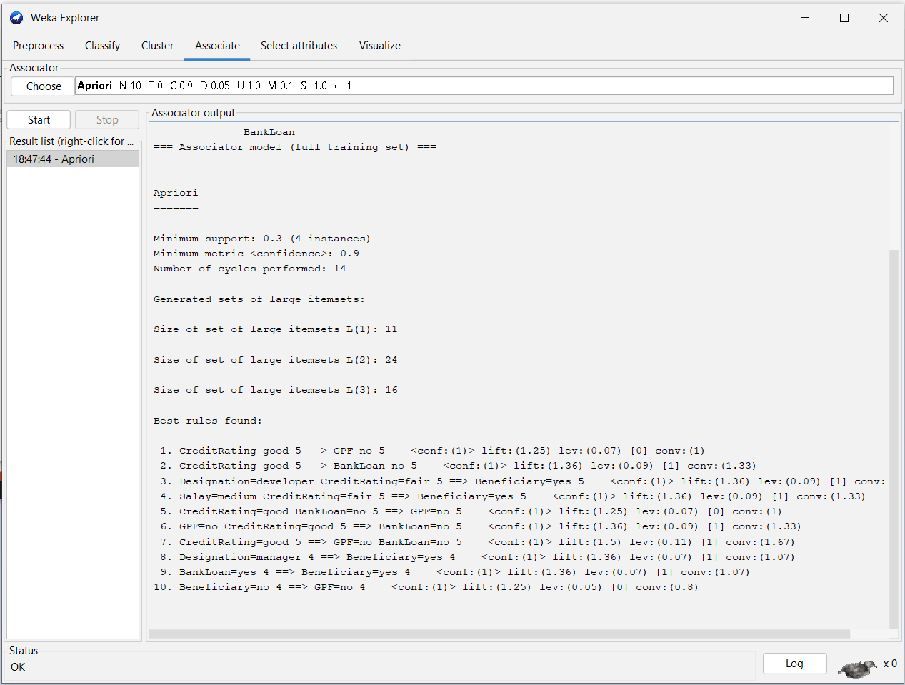
Task 4.2: Apply Apriori Algorithm with default Parameters.
Experiment 4
Association Rule Mining…
Apriori Rule Learner…

Slide 49
Task 4.2: Apply Apriori Algorithm with default Parameters…
Experiment 4
Association Rule Mining…
Apriori Rule Learner…
Default Parameters | Observations
lowerBoundMinSupport = upperBoundMinSupport = metricType = minMetric = numRules = | Minimum support = Minimum Metric <Confidence> = Number of cycles performed = Best rules found with confidence: 1. 2. 3. 4. 5. 6. 7. 8. 9. 10.

Slide 50
Task 4.3: Apply Apriori Algorithm with required Parameters.
Experiment 4
Parameters | Observations
lowerBoundMinSupport = upperBoundMinSupport = metricType = minMetric = numRules = | Minimum support = Minimum Metric <Confidence> = Number of cycles performed = Best rules found with confidence:

Slide 51
Experiment 5
Classification Using J48 Algorithm With Percentage Split

Slide 52
Tasks
01
02
03
Experiment 5
Load iris.arff dataset and explore it.
Build a classification model using J48 algorithm with percentage split.
Make predictions on new data.

Slide 53
Task 5.1: Load iris.arff dataset and explore it.
Experiment 5
Load iris.arff from the Weka’s data folder.
Attribute | Type | Range / States
Number of Instances:

Slide 54
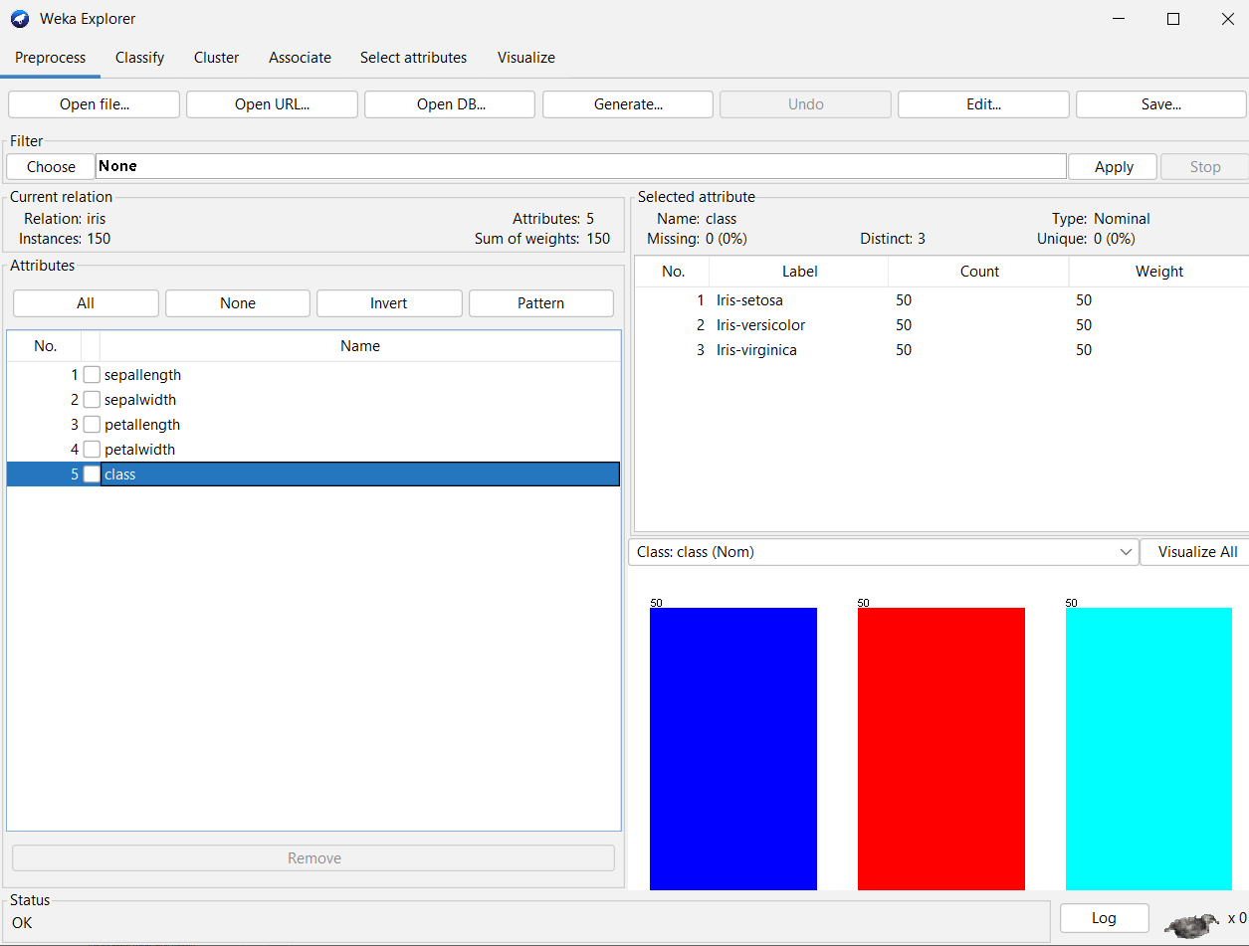
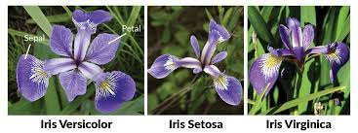
Task 5.1: Load iris.arff dataset and explore it.
Experiment 5
Load iris.arff from the Weka’s data folder…

Slide 55
Task 5.2: Build a classification model using J48.
Experiment 5
Classification:
Determining the class (state) of the given instance.
Examples:
Determining Play or Not play based on weather conditions.
Determining the digit (0 – 9) given the image pixel data.
Determining the Spam or Not-spam based on mail text.
J48:
Weka’s Java implementation of the C4.5 algorithm.
Can generate pruned or unpruned tress with both nominal and numerical attributes.

Slide 56
Task 5.2: Build a classification model using J48.
Experiment 5
Percentage Split:
Splits the data into training and test subsets.
Training set is used to build the model.
Test set is used to evaluate the model performance.

Slide 57
Task 5.2: Build a classification model using J48.
Experiment 5
Steps:
Click on Classify and select Percentage split with required training percentage under Test options group.
Select Choose → classifiers → trees → J48.
Clock on Start.
Right click on model and click on Visualize tree.

Slide 58
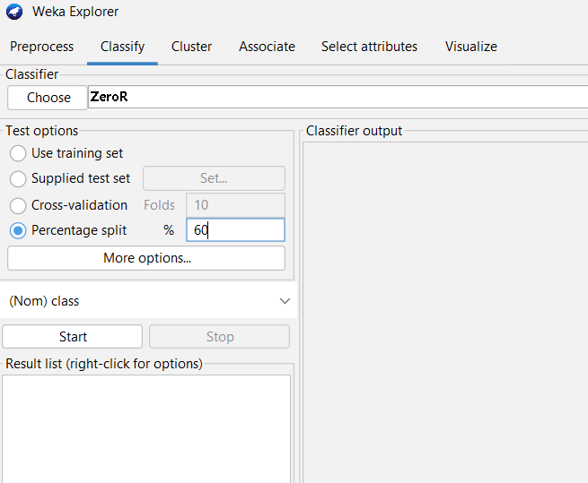
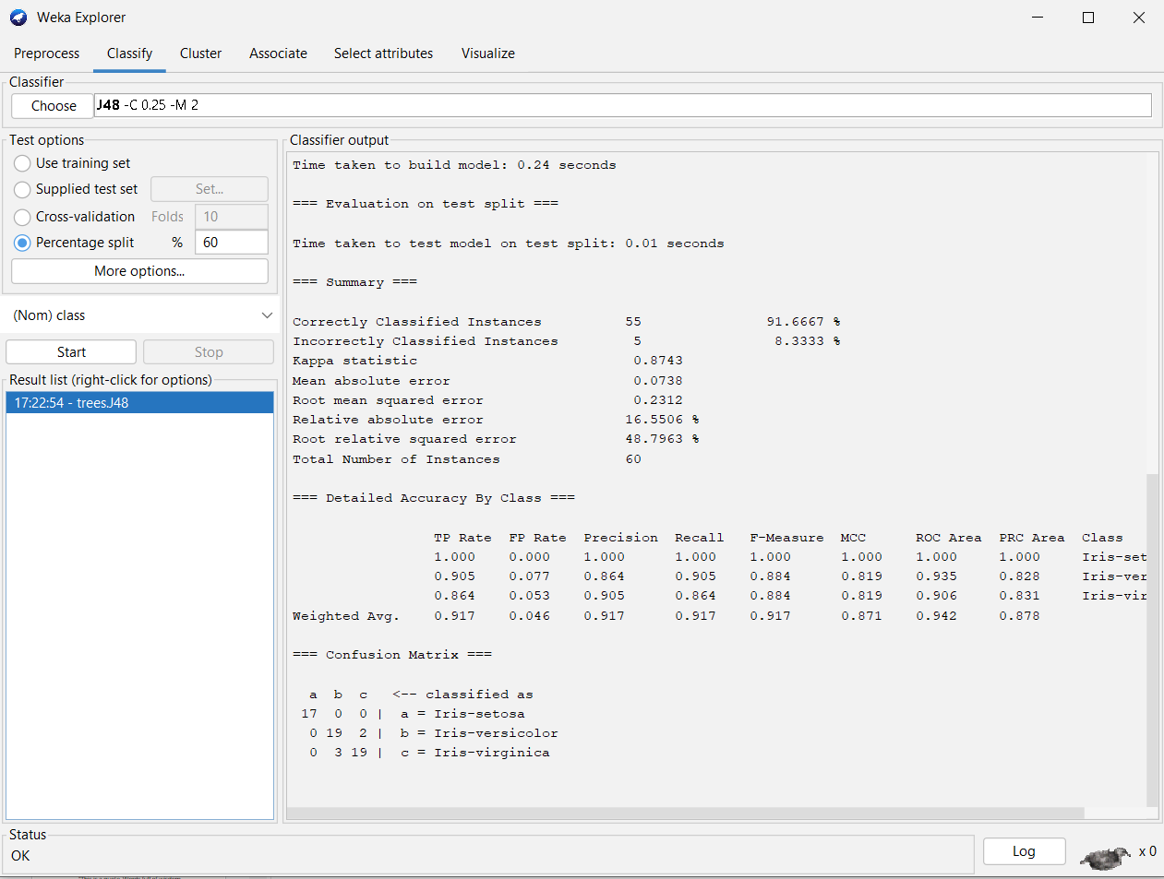
Task 5.2: Build a classification model using J48.
Experiment 5

Slide 59
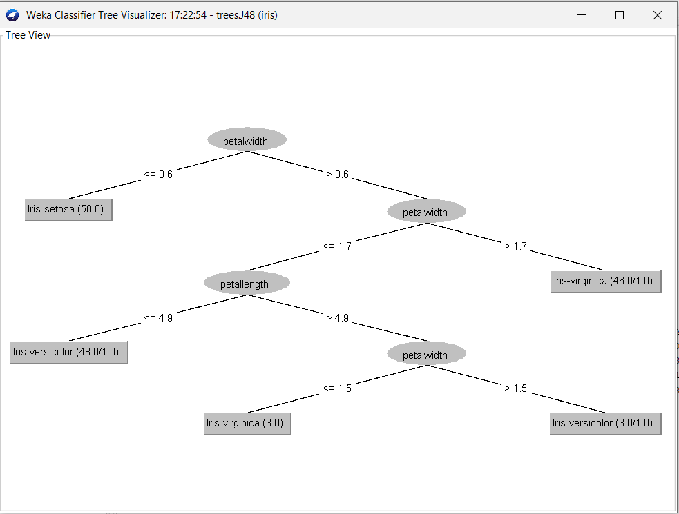
Task 5.2: Build a classification model using J48.
Experiment 5
Observations:
Total number of instances:
Correctly classified instances:
Incorrectly classified instances:
Accuracy:
Calculation of Accuracy from Confusion Matrix:

Slide 60
Task 5.3: Make predictions on new data.
Experiment 5
Steps:
Create an ARFF file with unlabeled (with ? In the place of class label) instances.
On the “Classify” tab, select the “Supplied test set” option in the “Test options” pane.
Click the “Set” button, click the “Open file” button on the options window and select the new dataset.
Click the “More options…” button and for the “Output predictions” option click the “Choose” button and select “PlainText”.
Right click on the model in the “Results list” pane and Select “Re-evaluate model on current test set”.

Slide 61
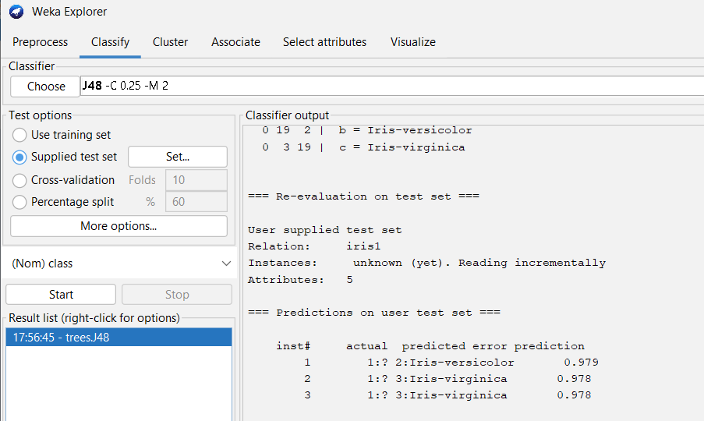
Task 5.3: Make predictions on new data.
Experiment 5
@relation iris1
@attribute sepallength numeric
@attribute sepalwidth numeric
@attribute petallength numeric
@attribute petalwidth numeric
@attribute class {Iris-setosa,Iris-versicolor,Iris-virginica}
@data
4.5,3.0,4.1,1.0,?
5.6,4.2,6.4,2.5,?
7.8,4.4,1.5,2.2,?

Slide 62
Task 5.3: Make predictions on new data.
Experiment 5
Observations:
Instance No. | Predicted class

Slide 63
Experiment 6
Classification Using J48 Algorithm With Cross-validation

Slide 64
Tasks
01
02
03
Experiment 6
Create SttudentResults.arff dataset and load it into Weka
Build a classification model using J48 algorithm with k-fold cross validation.
Make predictions on new data.

Slide 65
Task 6.1: Create StudentResults.arff dataset and load it.
Experiment 6
Create StudentResults.arff with following attributes and load it into Weka.
Attribute | Type
SSC | Nominal with states First, Second, Third.
Inter | Nominal with states First, Second, Third.
Marks1 | Numeric
Marks2 | Numeric
Marks3 | Numeric
Result | Nominal with states Pass & Fail

Slide 66
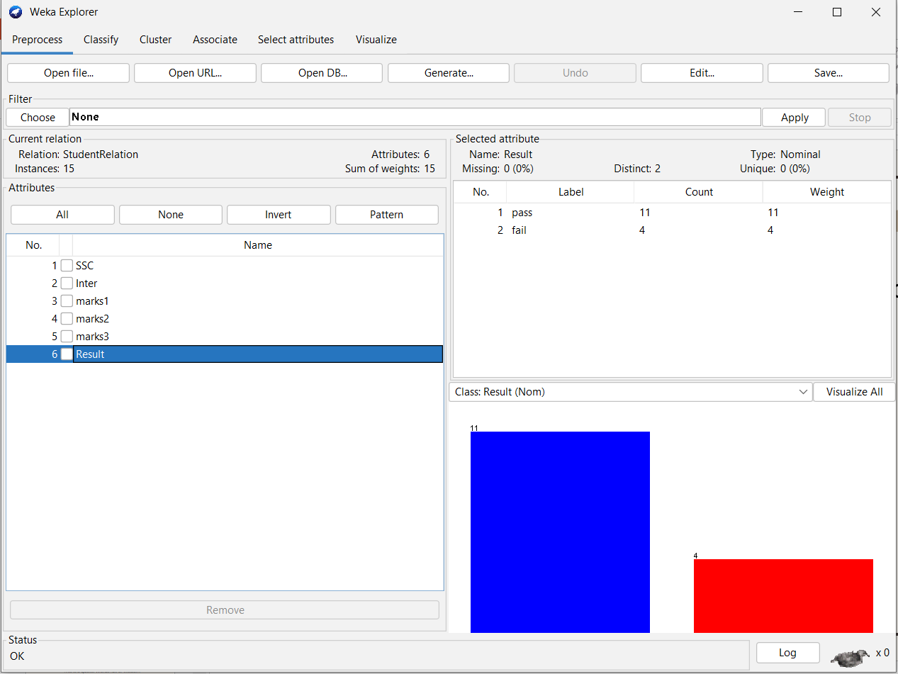
Task 6.1: Create StudentResults.arff dataset and load it.
Experiment 6
Create StudentResults.arff with following attributes and load it into Weka…
@relation StudentRelation
@attribute SSC {first,second,third}
@attribute Inter {first,second,third}
@attribute marks1 numeric
@attribute marks2 numeric
@attribute marks3 numeric
@attribute Result {pass, fail}
@data
first,second,55,57,62,pass
first,first,63,63,55,pass
first,first,65,67,66,pass
first,first,76,77,82,pass
second,third,32,43,23,fail
first,first,67,76,57,pass
second,second,56,54,45,pass
second,second,56,65,57,pass
third,third,34,23,12,fail
second,third,23,34,23,fail
second,first,65,64,56,pass
first,first,65,66,67,pass
third,third,45,32,23,fail
first,first,56,63,73,pass
second,first,65,56,57,pass

Slide 67
Task 6.2: Build a classification model using J48.
Experiment 6
Classification: Determining the class (state) of the given instance.
J48: Weka’s Java implementation of the C4.5 algorithm.

Slide 68
Task 6.2: Build a classification model using J48.
Experiment 6
K-fold Cross Validation:
Resampling procedure used to evaluate machine learning models on a limited data set.
Process:
Split the input dataset into K groups
For i from 1 to k
Take i^{th} group as test dataset.
Use remaining K-1 groups as training dataset.
Fit the model using training set and evaluate its performance on test set.

Slide 69
Task 6.2: Build a classification model using J48.
Experiment 6
Steps:
Click on Classify and select Cross-validation with some number of folds under Test options group.
Select Choose → classifiers → trees → J48.
Clock on Start.
Right click on model and click on Visualize tree.

Slide 70
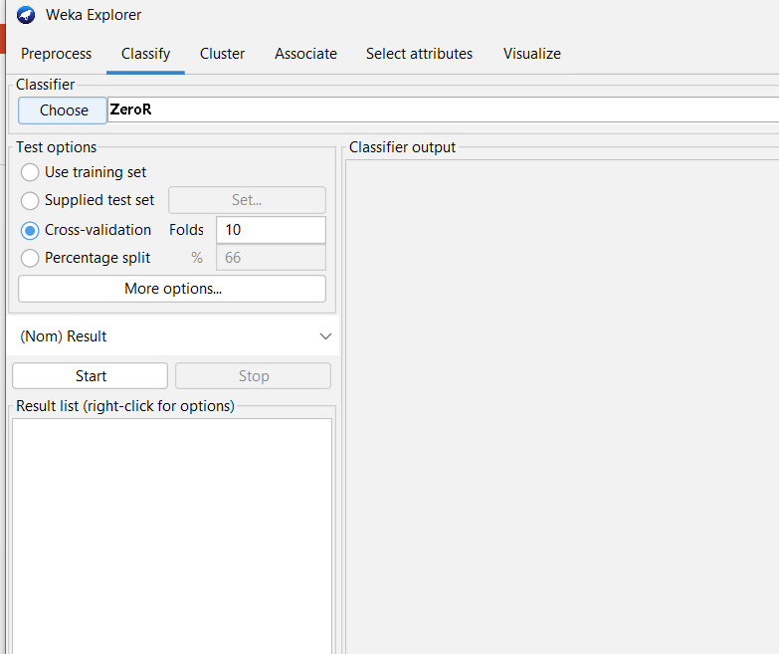
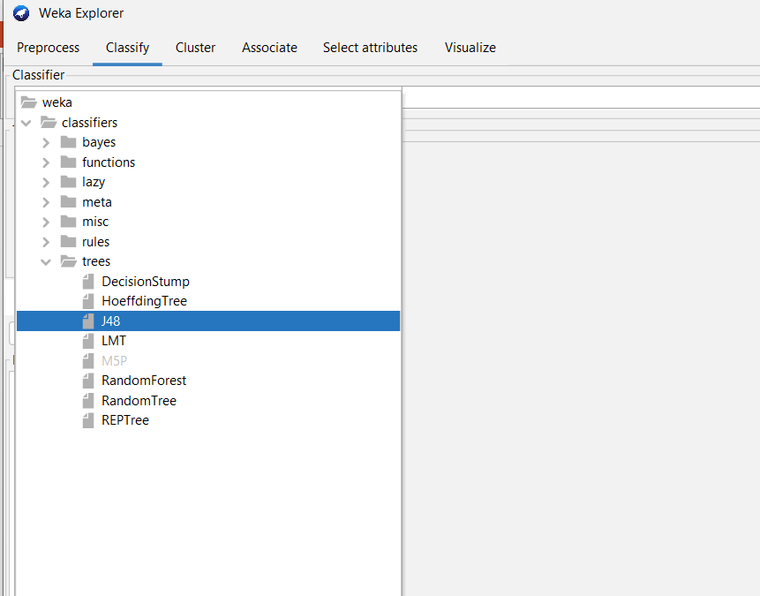
Task 6.2: Build a classification model using J48.
Experiment 6

Slide 71
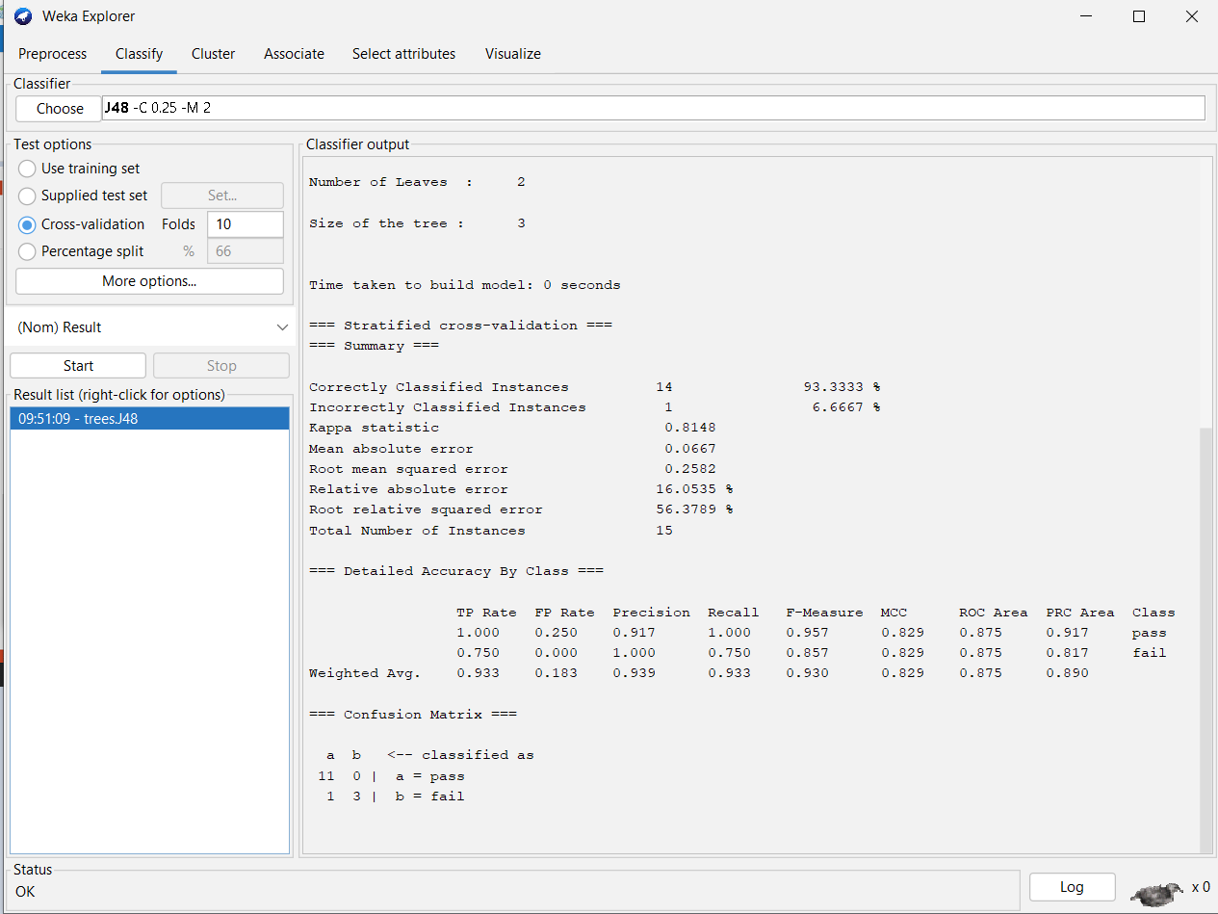
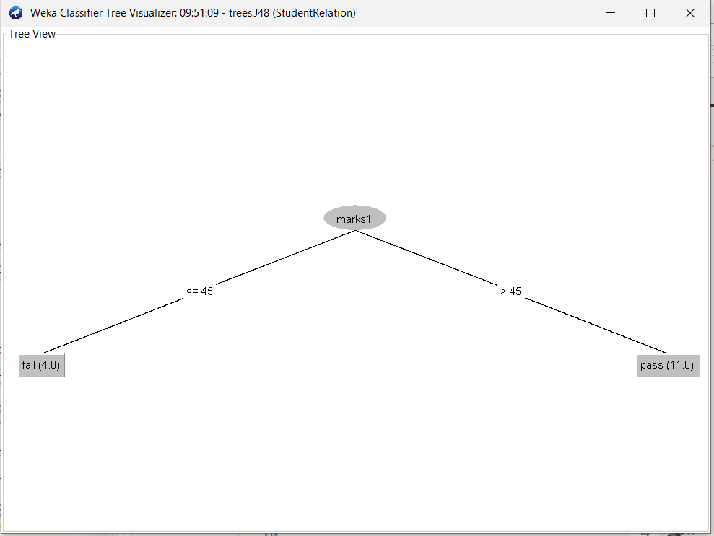
Task 6.2: Build a classification model using J48.
Experiment 6

Slide 72
Task 6.2: Build a classification model using J48.
Experiment 6
Observations:
Total number of instances:
Correctly classified instances:
Incorrectly classified instances:
Accuracy:
Calculation of Accuracy from Confusion Matrix:

Slide 73
Task 6.3: Make predictions on new data.
Experiment 6
Steps:
Create an ARFF file with unlabeled (with ? In the place of class label) instances.
On the “Classify” tab, select the “Supplied test set” option in the “Test options” pane.
Click the “Set” button, click the “Open file” button on the options window and select the new dataset.
Click the “More options…” button and for the “Output predictions” option click the “Choose” button and select “PlainText”.
Right click on the model in the “Results list” pane and Select “Re-evaluate model on current test set”.

Slide 74
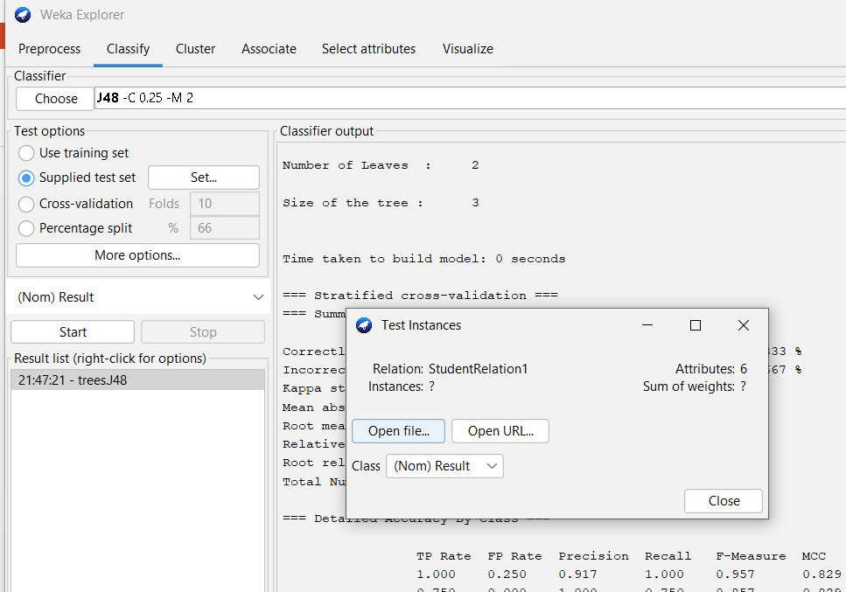
Task 6.3: Make predictions on new data.
Experiment 6
@relation StudentRelation1
@attribute SSC {first,second,third}
@attribute Inter {first,second,third}
@attribute marks1 numeric
@attribute marks2 numeric
@attribute marks3 numeric
@attribute Result {pass, fail}
@data
first,first,76,67,75,?
second,third,32,43,32,?
first,first,65,36,37,?

Slide 75
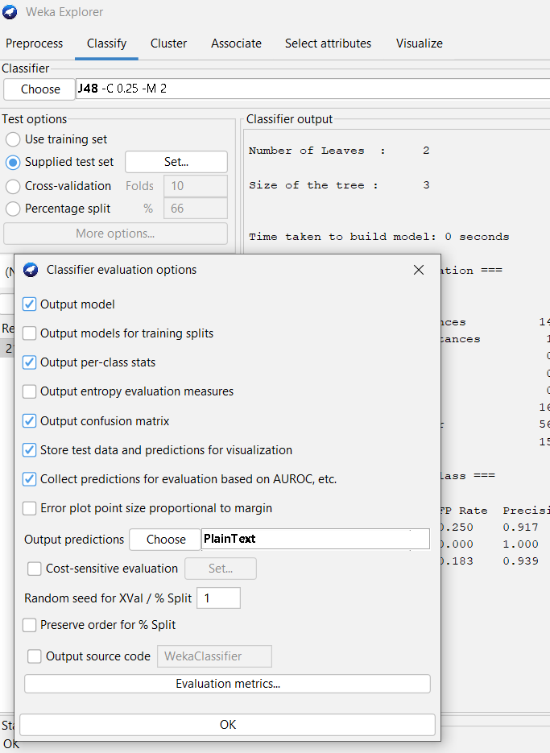
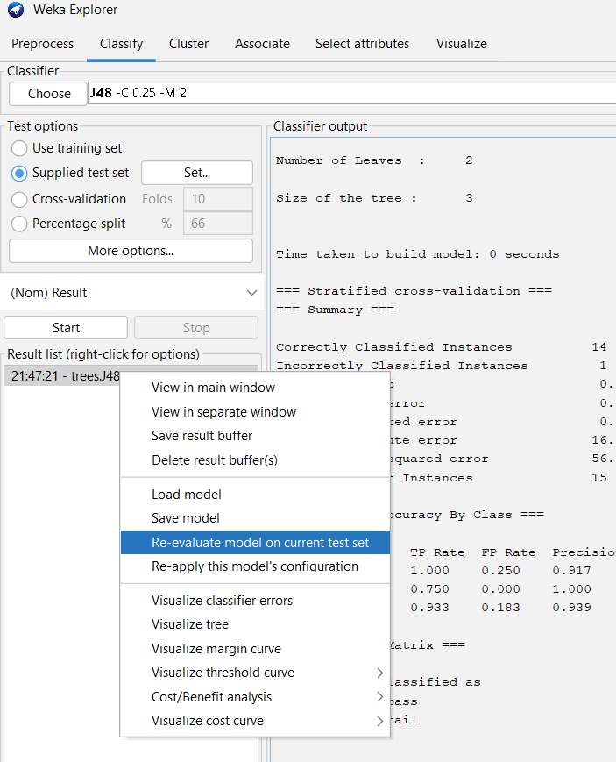
Task 6.3: Make predictions on new data.
Experiment 6

Slide 76
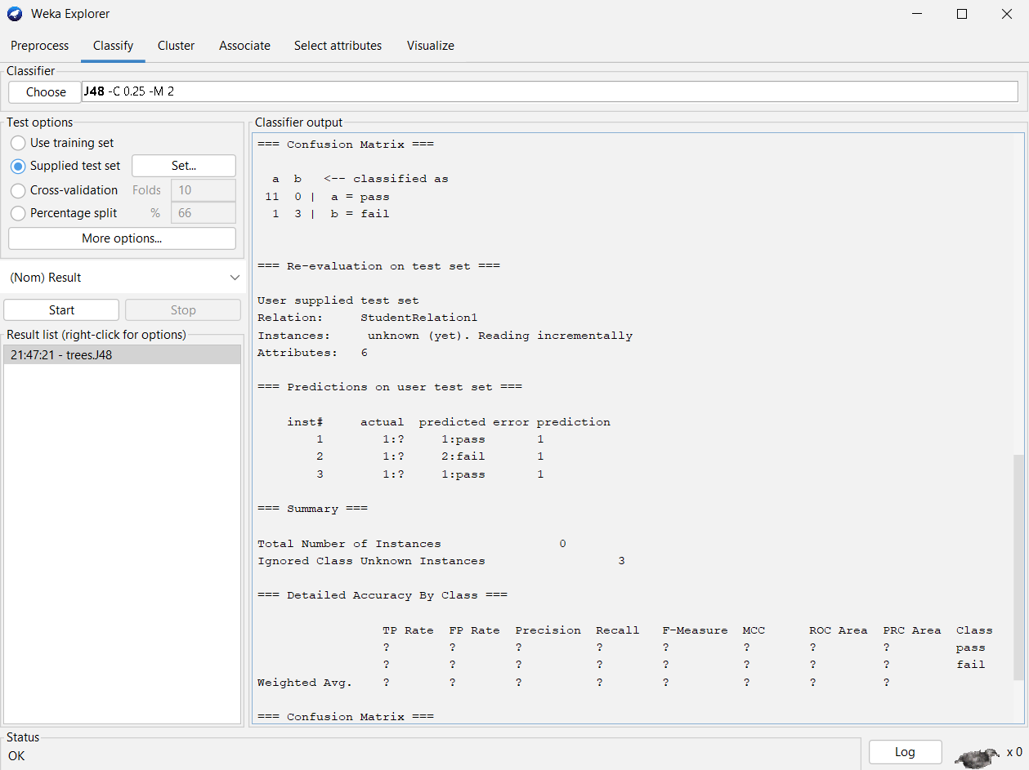
Task 6.3: Make predictions on new data.
Experiment 6
Observations:
Instance No. | Predicted class

Slide 77
Experiment 7
Classification Using ID3 Algorithm With Cross-validation

Slide 78
Tasks
01
02
03
04
Experiment 7
Install required package for ID3
Load contact-lenses.arff dataset
Build a classification model using ID3 algorithm with k-fold cross validation.
Make predictions on new data.

Slide 79
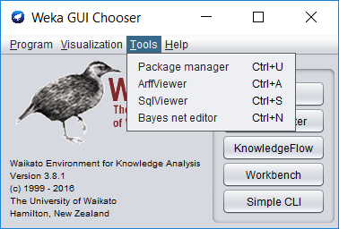
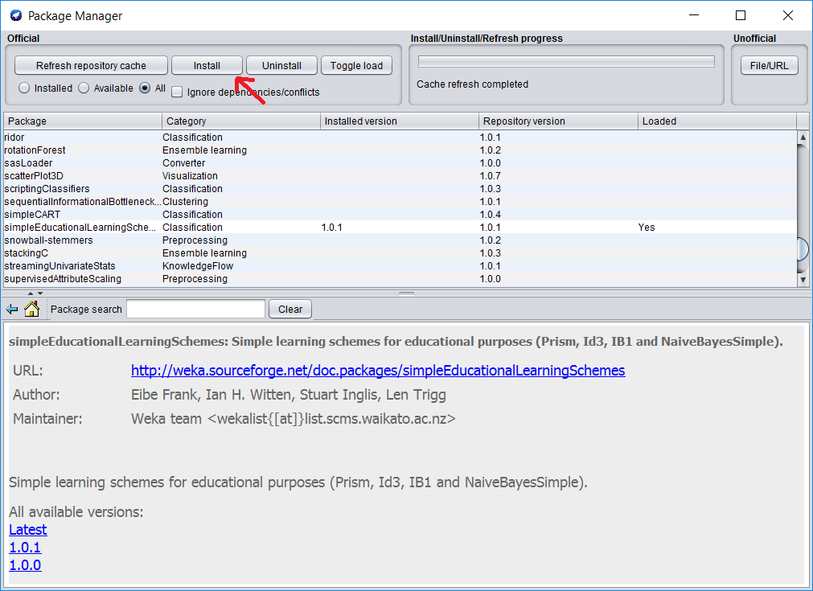
Task 7.1: Install required package for ID3
Experiment 7
Select GUI Chooser → Tools → Package Manager
Search, select & install simpleEducationalLearningSchemes package to get ID3 classifier under trees group.

Slide 80
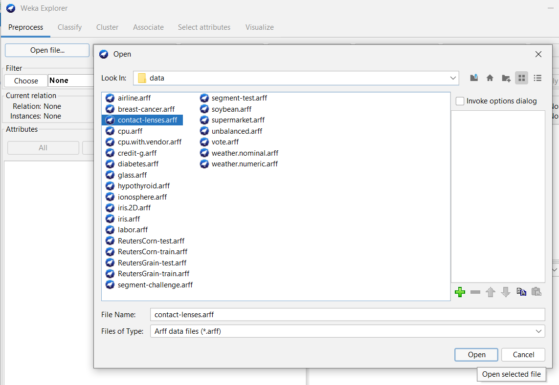
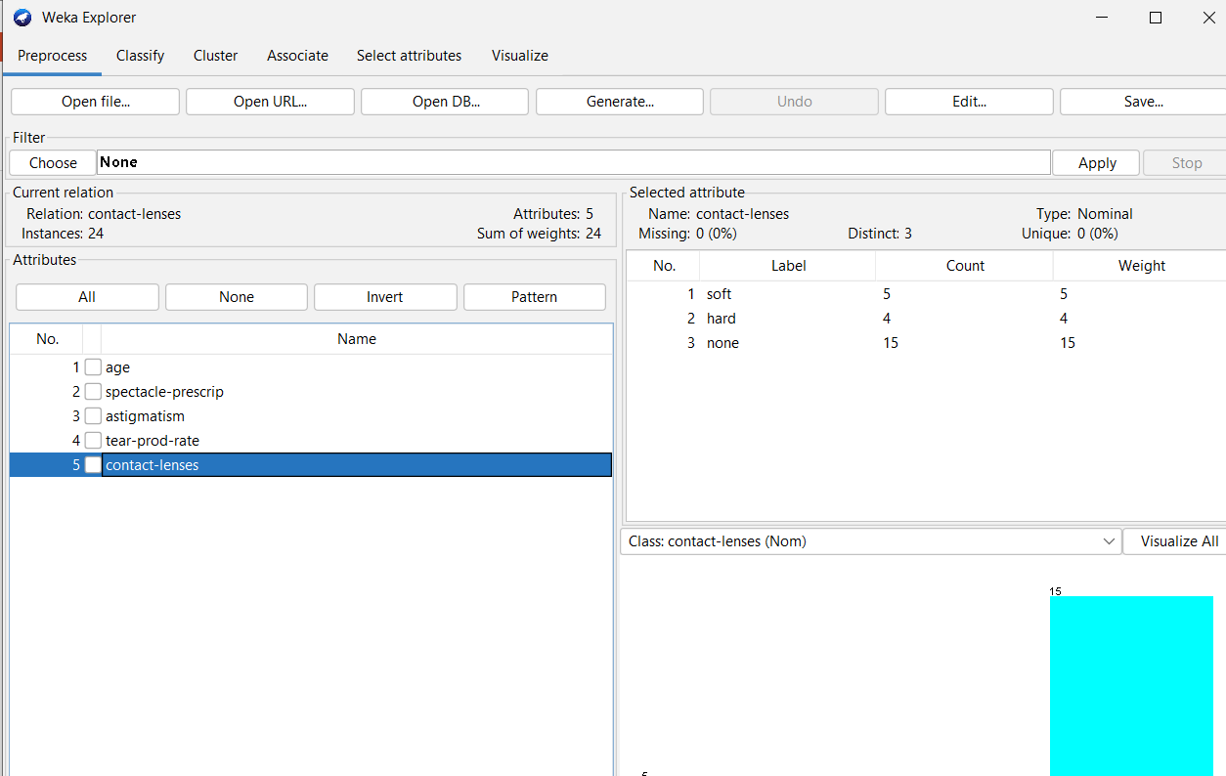
Task 7.2: Load contact-lenses.arff dataset and explore it.
Experiment 7
Load contact-lenses.arff from the Weka’s data folder.
Note: ID3 works with Nominal attributes only

Slide 81
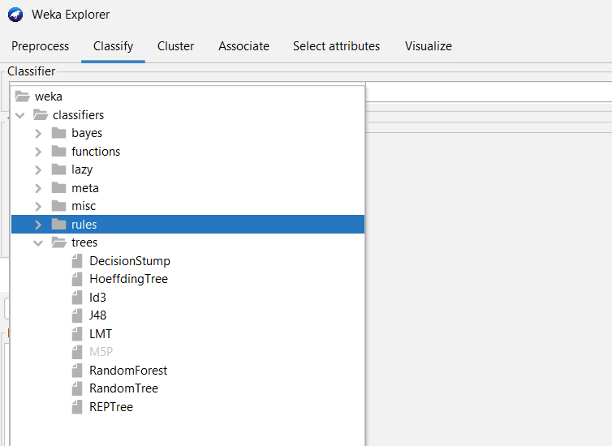
Task 7.3: Build a classification model using ID3.
Experiment 7
Steps:
Click on Classify and select Cross-validation with some number of folds under Test options group.
Select Choose → classifiers → trees → ID3.
Clock on Start.
Note: We can’t visualize tree with ID3

Slide 82
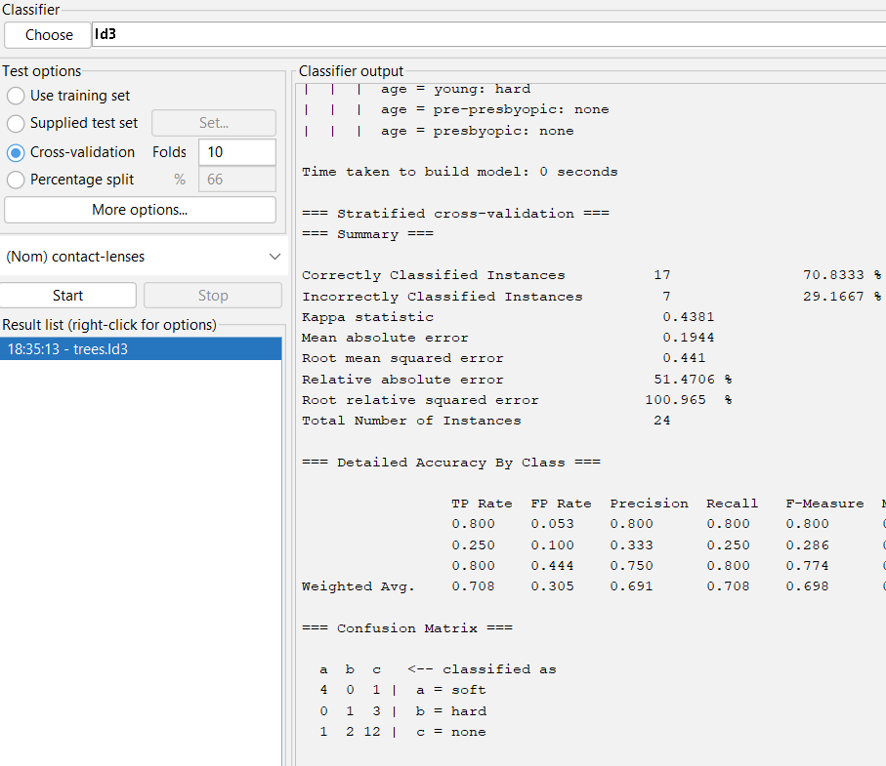
Task 7.3: Build a classification model using ID3.
Experiment 7
Observations:
Total number of instances:
Correctly classified instances:
Incorrectly classified instances:
Accuracy:
Calculation of Accuracy from Confusion Matrix:

Slide 83
Task 7.4: Make predictions on new data.
Experiment 7
Steps:
Create an ARFF file with unlabeled (with ? In the place of class label) instances.
On the “Classify” tab, select the “Supplied test set” option in the “Test options” pane.
Click the “Set” button, click the “Open file” button on the options window and select the new dataset.
Click the “More options…” button and for the “Output predictions” option click the “Choose” button and select “PlainText”.
Right click on the model in the “Results list” pane and Select “Re-evaluate model on current test set”.

Slide 84
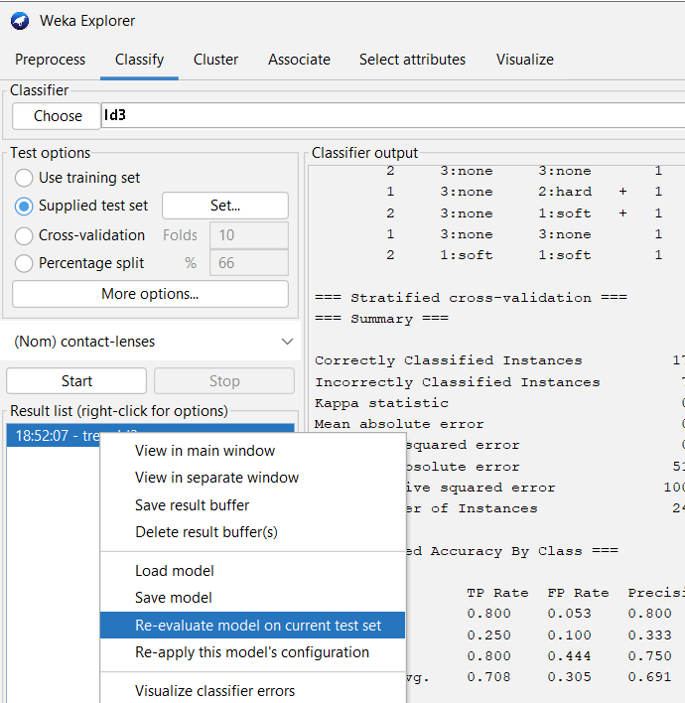
Task 7.4: Make predictions on new data.
Experiment 7
@relation contact-lenses1
@attribute age {young, pre-presbyopic, presbyopic}
@attribute spectacle-prescrip {myope, hypermetrope}
@attribute astigmatism {no, yes}
@attribute tear-prod-rate {reduced, normal}
@attribute contact-lenses {soft, hard, none}
@data
young,hypermetrope,no,normal,?
presbyopic,hypermetrope,no,normal,?
presbyopic,myope,no,normal,?

Slide 85
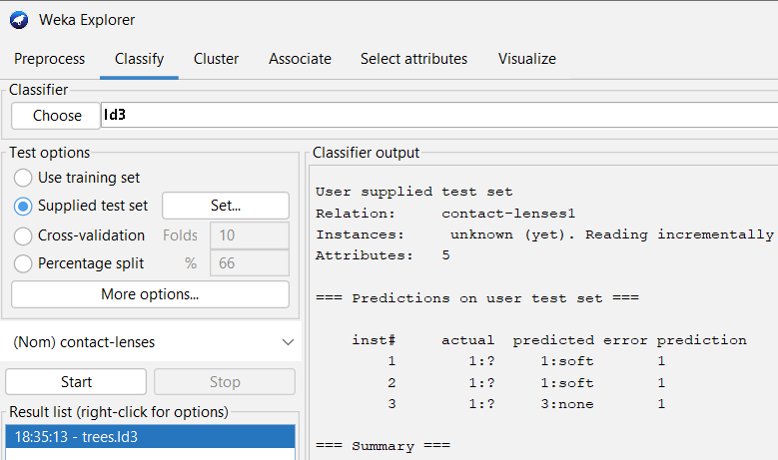
Task 7.4: Make predictions on new data.
Experiment 7
Observations:
Instance No. | Predicted class

Slide 86
Experiment 8
Classification Using Naive Bayes Algorithm With Cross-validation

Slide 87
Tasks
01
02
03
Experiment 8
Load contact-lenses.arff dataset
Build a classification model using Naive Bayes algorithm with k-fold cross validation.
Make predictions on new data.

Slide 88
Task 8.1: Load contact-lenses.arff dataset and explore it.
Experiment 8
Load contact-lenses.arff from the Weka’s data folder.

Slide 89
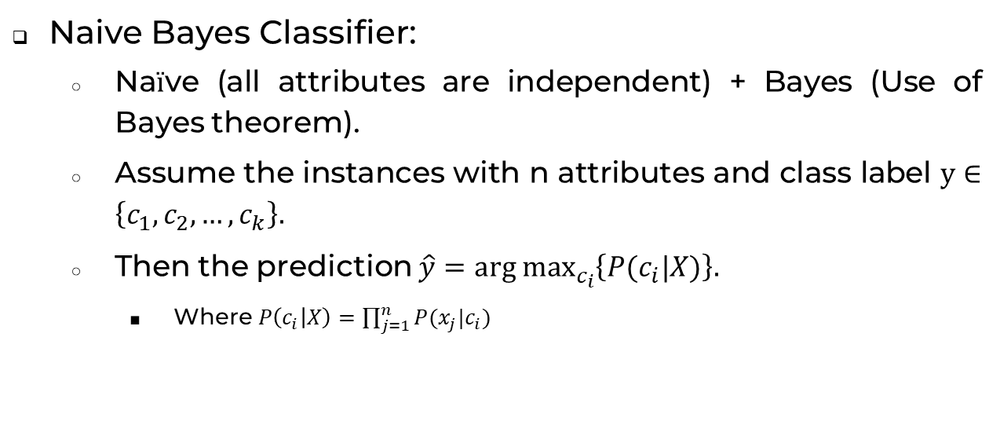
Task 8.2: Build a classification model using Navie Bayes.
Experiment 8
Naive Bayes Classifier:
Naïve (all attributes are independent) + Bayes (Use of Bayes theorem).
Assume the instances with n attributes and class label $y∈\left\{c_{1},c_{2},…,c_{k}\right\}.$
Then the prediction $\hat{y}=\underset{c_{i}}{arg max}\left\{P(c_{i}|X)\right\}.$
Where $P\left(c_{i} | X\right)=\prod_{j=1}^{n}{P(x_{j}|c_{i})}$

Slide 90
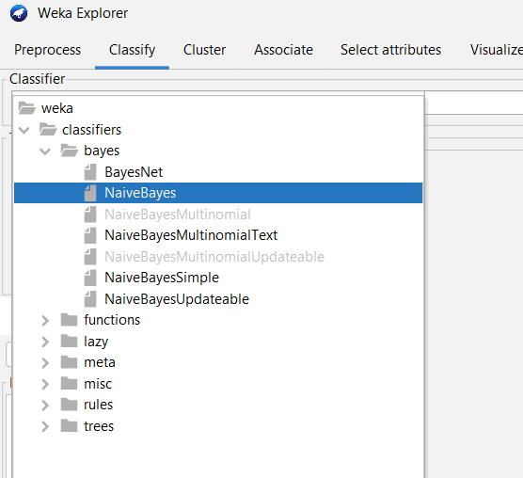
Task 8.2: Build a classification model using Navie Bayes.
Experiment 8
Steps:
Click on Classify and select Cross-validation with some number of folds under Test options group.
Select Choose → classifiers → bayes → Naïve Bayes.
Clock on Start.

Slide 91
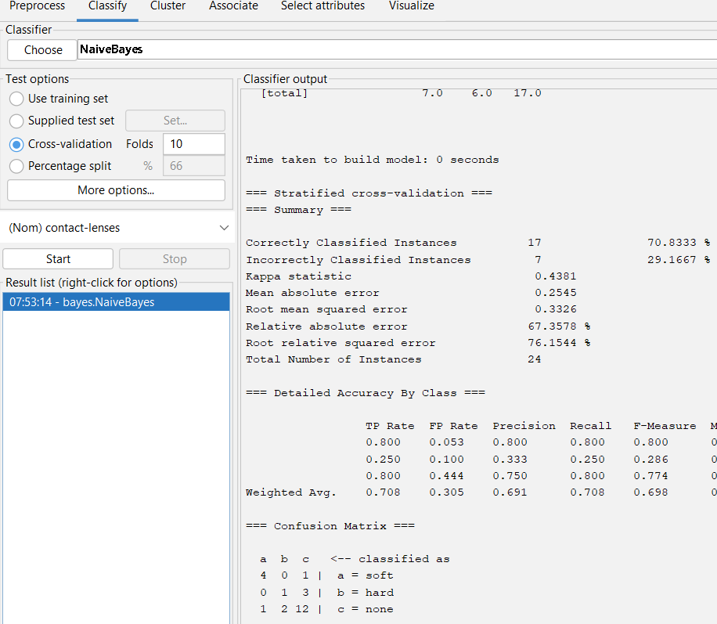
Task 8.2: Build a classification model using Nave Bayes.
Experiment 8
Observations:
Total number of instances:
Correctly classified instances:
Incorrectly classified instances:
Accuracy:
Calculation of Accuracy from Confusion Matrix:

Slide 92
Task 8.3: Make predictions on new data.
Experiment 8
Steps:
Create an ARFF file with unlabeled (with ? In the place of class label) instances.
On the “Classify” tab, select the “Supplied test set” option in the “Test options” pane.
Click the “Set” button, click the “Open file” button on the options window and select the new dataset.
Click the “More options…” button and for the “Output predictions” option click the “Choose” button and select “PlainText”.
Right click on the model in the “Results list” pane and Select “Re-evaluate model on current test set”.

Slide 93
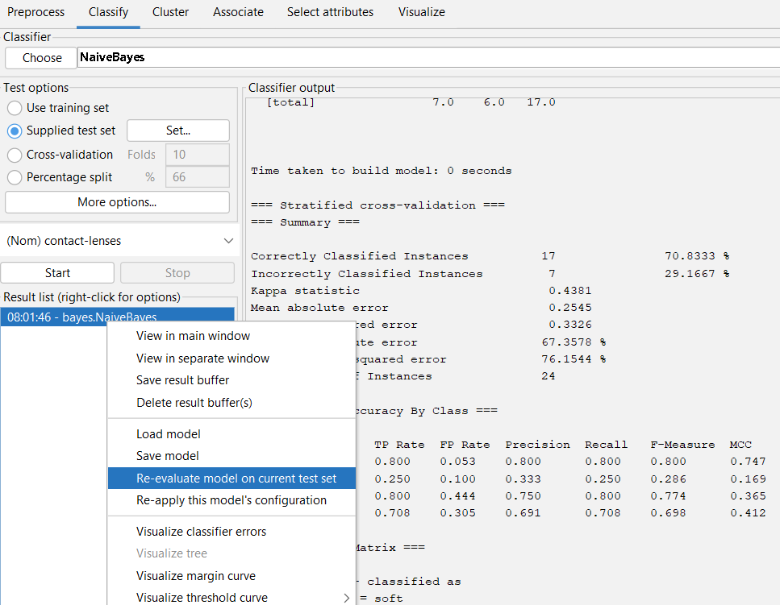
Task 8.3: Make predictions on new data.
Experiment 8
@relation contact-lenses1
@attribute age {young, pre-presbyopic, presbyopic}
@attribute spectacle-prescrip {myope, hypermetrope}
@attribute astigmatism {no, yes}
@attribute tear-prod-rate {reduced, normal}
@attribute contact-lenses {soft, hard, none}
@data
young,hypermetrope,no,normal,?
presbyopic,hypermetrope,no,normal,?
presbyopic,myope,no,normal,?

Slide 94
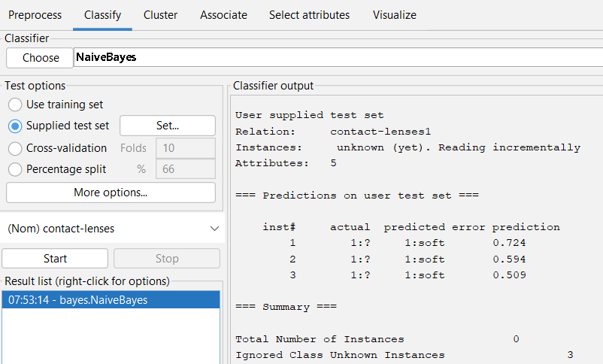
Task 8.4: Make predictions on new data.
Experiment 8
Observations:
Instance No. | Predicted class

Slide 95
Experiment 9
Clustering Iris Dataset using K-Means Algorithm

Slide 96
Tasks
01
02
03
Experiment 9
Load weka’s iris.arff dataset
Use simple K-means algorithm to the dataset.
Visualize the clusters.

Slide 97
Task 9.1: Load iris.arff dataset and remove target attribute.
Experiment 9
Load iris.arff from the Weka’s data folder.
Select Choose → filter → unsupervised → attribute → Remove.
Click on filter and enter target attribute index.
Click on Apply.
Click on Visualize to observe the number of clusters that dataset may have.

Slide 98
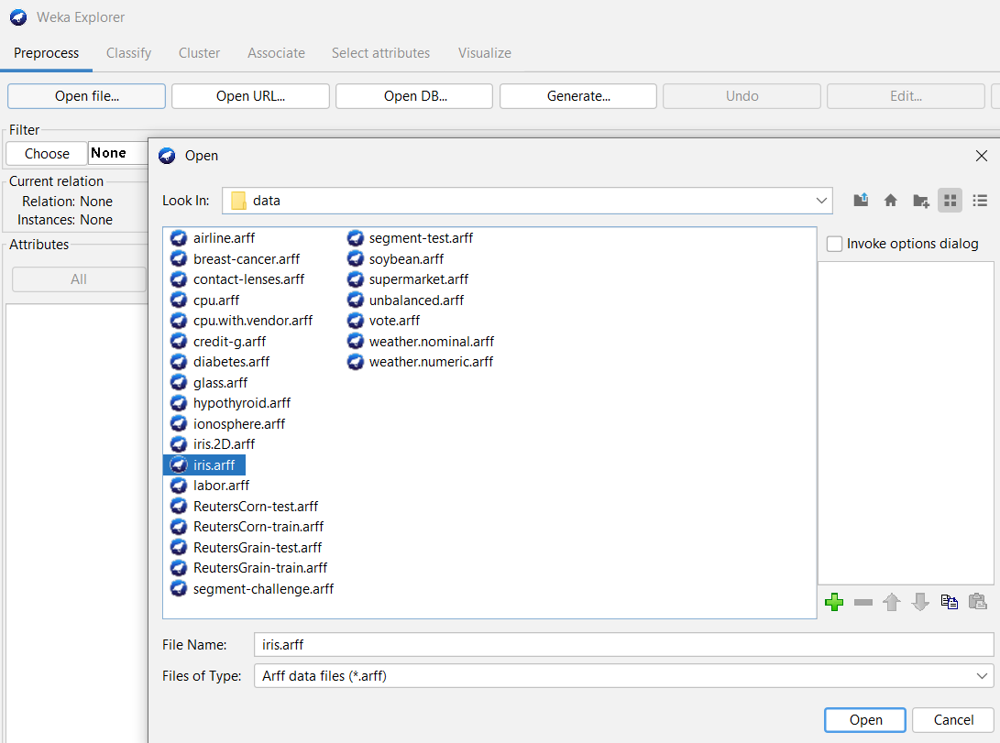

Task 9.1: Load iris.arff dataset and remove target attribute.
Experiment 9

Slide 99


Task 9.1: Load iris.arff dataset and remove target attribute.
Experiment 9

Slide 100

Task 9.2: Cluster the dataset using k-means algorithm.
Experiment 9
Clustering:
A clustering algorithm finds groups of similar instances in the entire dataset.
Unsupervised learning technique.

Slide 101
Task 9.2: Cluster the dataset using k-means algorithm.
Experiment 9
K-Means Clustering:
Required to specify the number of clusters (K) needed in advance.
Process:
Randomly K initial cluster centers are chosen.
All instances are assigned to closest cluster centers according to the Euclidean distance measure.
Cluster centers are updated based on the mean values of all instances in their respective clusters.
Steps ii and iii are repeated until cluster centers are stabilized.

Slide 102
Task 9.2: Cluster the dataset using k-means algorithm.
Experiment 9
Open Explorer → Cluster window.
Select the Use training set option in Cluster mode pane.
Check the Store clusters for visualization option.
Select Choose → Clusters → SimpleKMeans.
Click on SimpleKMeans and set the number of clusters.
Click on Start.

Slide 103


Task 9.2: Cluster the dataset using k-means algorithm.
Experiment 9

Slide 104

Task 9.2: Cluster the dataset using k-means algorithm.
Experiment 9
Number of Iterations:
Starting random cluster centroids:
Final cluster centroids:
Number of instances in each cluster:

Slide 105


Task 9.3: Visualizing the clusters.
Experiment 9
Right click on the clustering model in Result list.
Click on Visualize cluster assignment.
Save the result in arff format.

Slide 106

Task 9.3: Visualizing the clusters.
Experiment 9

Slide 107
Experiment 10
Clustering an User’s Dataset using K-Means Algorithm

Slide 108
Tasks
01
02
03
Experiment 10
Collect the data and load the dataset
Use simple K-means algorithm to the dataset.
Visualize the clusters.

Slide 109

Experiment 10
Task 1
Collect the data from your friends with Name, weight(kgs) and height(inches) attributes.
Create a CSV file.
Load it into weka.
Remove Name column.

Slide 110

Experiment 10
Task 2
Build a clustering model to divide the dataset in to male and female groups using k-means algorithm.

Slide 111

Experiment 10
Task 3
Visualize and save the results.

